Slide 1
Theories of Population Growth
AP Human Geography

Slide 2
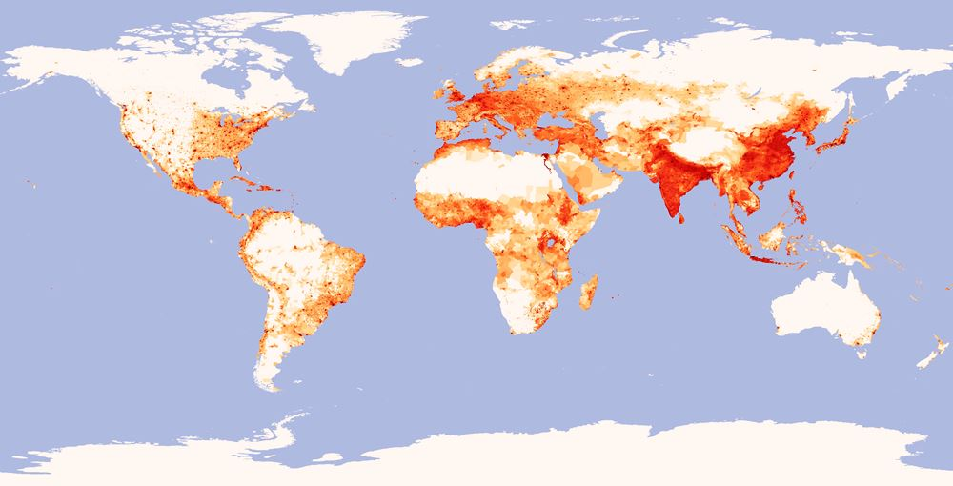
Population Distribution
Where on each Continent are population centers?

Slide 3
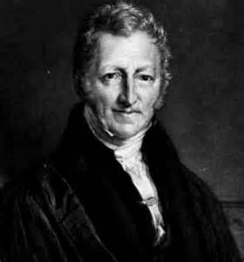
Thomas Malthus
Was first to note that the world’s population was increasing faster than the food supply needed to sustain it.
Believed population growth could be stopped by birth control or abstinence; though highly unlikely.
Instead, believed population growth would be checked by famine, accompanied by disease and wars fought on earth.

Slide 4
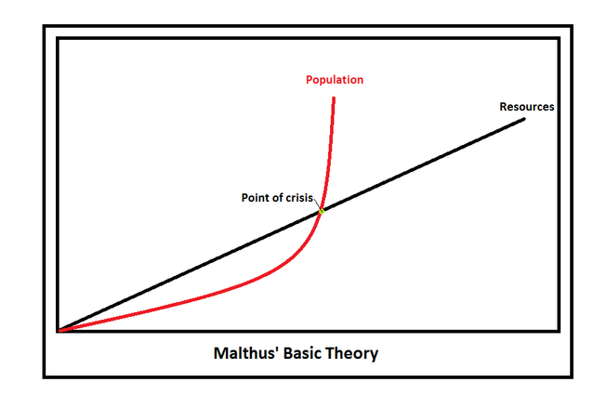
Malthus Basic Theory

Slide 5
Ernst Ravenstein
Wrote 11 migration laws, based on his study of internal migration including:
Distance decay: the decline of an activity with increasing distance from its point of origin.
Step migration: long term migration done in stages EX: rural to town, town to city
Intervening opportunity: many who set out to move a long distance find opportunities to settle before their original destination

Slide 6
Demographic Transition Theory
States that variations in fertility and mortality rates, and natural increase rates vary considerably
These variations follow and overall global pattern.
All countries go through 4 stages

Slide 7
DTT Stage 1
Low Growth
Preindustrial, agrarian societies
High birth rates to work farms, little access to birth control
Death rates are high due to low standards of living
Characterized population until mid-18th century

Slide 8
DTT Stage 2
High Growth
Industrialization bouth about demgraphic transition.
Greater food supplies and medicine; birth rates stayed high, natural increase explodes.
Mortality revolution – Death rates dropped significantly in Europe.
Many of the world’s poorest countries are in this stage today.

Slide 9
DTT Stage 3
Moderate Growth
Mature industrial economy
Birth rate drops, curbs population
In Europe, rapid urbanization created more jobs in cities
Fertility rates fall because more children survive to adulthood
Children become economic liabilites rather than assets.

Slide 10
DTT Stage 4
Low Growth
Post-industrial economy completes demographic transition
Birth rate keeps falling; women are working outside the home
Higher education levels encourage women to delay marriage and children.
Steady death rates, population grows slowly or decreases.

Slide 11
Demographic Transition Theory
Has occurred in UK and much of Europe
Many demographers predict most countries will stop growing at some time in 21st century and reach stationary population level (SLP)

Slide 12
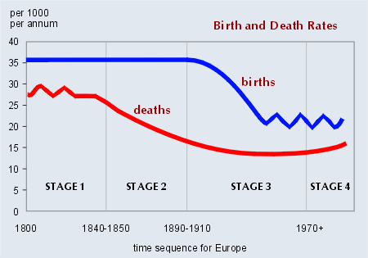
Demographic Transition Theory

