Slide 1
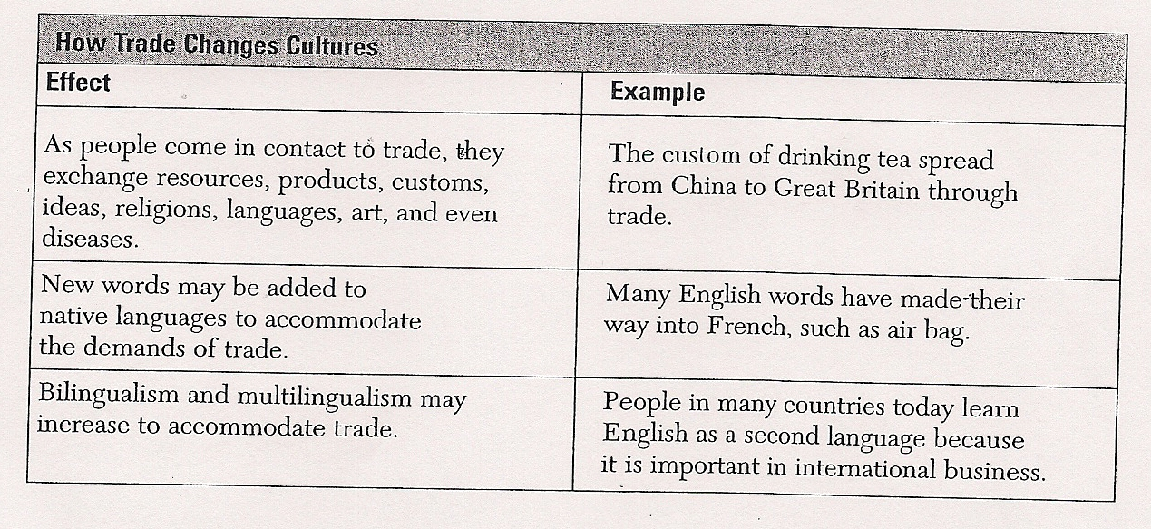
Bell Ringer #5a Cultural Changes
Trade may result in changes in a society’s…
language.
Customs.
Religion.
All of the above.

Slide 2
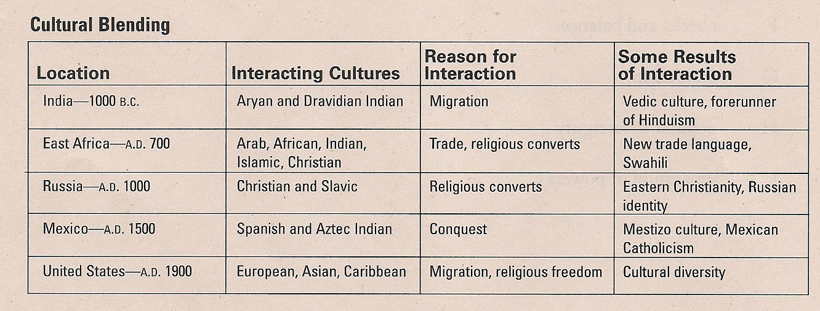
Bell Ringer #5b Cultural Changes
What do most of the cultural interactions in the chart have in common?
Most had a religious cause or effect.
Most had a clear economic cause.
Most were produced by war or conquest.
Most involved mass migration.

Slide 3
Day 5- Culture
Essential Questions-
How do social, political, and economic factors affect cultures and cause changes in the cultures over time?

Slide 4
Key Ideas
Concepts-
Identity, Belonging, Tradition, Patterns
Vocabulary-
Customs, Beliefs, Traditions, Diffusion, Cultural Convergence, Cultural Divergence, Diversity
Verbs-
Describe, Explain, Compare, Analyze, Identify, Evaluate, Assess

Slide 5
Culture – Draw a red heart on your map for each of the culture hearths on the map below.
Can you identify why each of these is a cultural hearth? Think history…..
Notes:
Teacher Script
Students will take out prepared maps and student resource packet.
Put the following maps on the projector.
Students will locate the different culture hearths on their world map. Students will draw a red heart these regions of their map.
Teacher will discuss each hearth
Students will complete the religion chart and glue it on the back of the map.
Students will use the symbols they created to label the major world religions on the map. Students will need to reference the Religion Map down below in this section.
Students will label languages on the map using the provided key and referencing the third map in this section. Students will cut out the Language Key from the student resources packet and glue it on the front of their map
Review Released Test Question #11, 12, 13
Closure: Cultural quiz available in culture section of student resource packet.

Slide 6
Religion – where did it start and where has it spread? Complete the religion chart on the back of your map…. Include the founder/location
Religion | Symbol | Origin | Characteristics
Judaism
Christianity
Islam
Hinduism
Buddhism
Sikhism
Animism

Slide 7
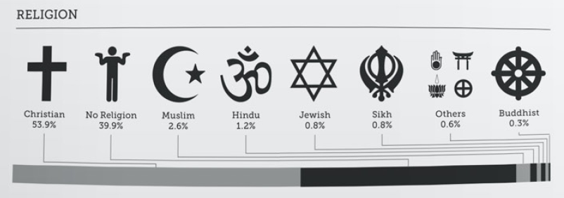

Slide 8
Use the symbols you created in your religion chart to mark the location of each religion on your map.

Slide 9
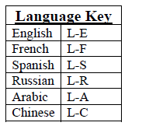
Language – cut the key to the left from your student packet and glue it under your physical key on your map and label languages on your map using this key.

Slide 10
Is your map starting to look like this?

Slide 11
Culture Puzzles
Divide into pairs and compete against another group
Stop

Slide 12
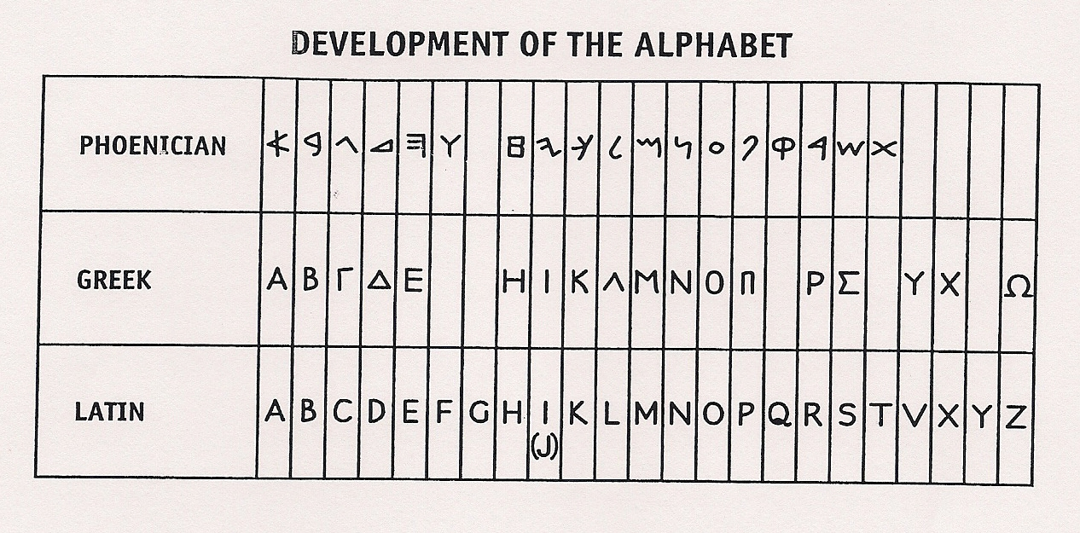
Bell Ringer #6a Cultural Changes
What conclusion can be drawn about the development of the alphabet?
The Phoenician, Greek, and Latin alphabets were unrelated.
The diffusion of ideas often has little impact on culture.
The use of an alphabet spread from Phoenicia to Greece and later to Rome.
A people’s culture often has a strong influence on its institutions.

Slide 13
Bell Ringer #6b Cultural Changes
In Japan, baseball games usually begin with ballplayers bowing to the opposing team. This practice shows the influence of both…
spatial diffusion and tradition.
interdependence and sacrifice.
nationalism and ethnocentrism.
geography and economics.

Slide 14
Conflicts
Draw the “caution” symbols onto the following sites on your map to represent these areas of conflict.
Ireland
Bosnia
Israel/Palestine
Rwanda
Sudan(Darfur)
South Africa
!
Types of Conflict
Political
Ethnic
Economic
Religious
Notes:
Teacher Script
Students will take out prepared maps and student resource packet.
Have the students cut out the “Caution” symbols from the conflict section of their student resource packet and glue them onto the sites for the following conflicts: Ireland, Bosnia, Israel, Rwanda, Sudan, South Africa, Chechnya, Uganda, and North Korea
Have the students discuss the reasons behind conflicts that occur: political, ethnic, economic, and religious. Then, have students determine which kind of conflict applies to each example and fill in the box for each. Some conflicts have multiple causes (i.e. religious and ethnic)
Now have the students cut out and glue the visual aids onto the conflict box that best fits (two pictures per conflict).
Cut out each chart and glue them on the back of the map.
Exit slip-How is conflict seen through the eyes of differing cultures?

Slide 15
Conflicts continued….
Determine which kinds of conflict apply to the countries using the boxes provided.
Label them in on the back of your map.
Types of Conflict
Political
Ethnic
Economic
Religious

Slide 16
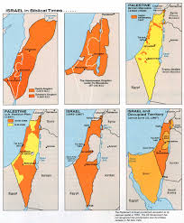
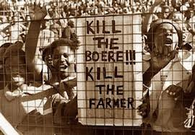
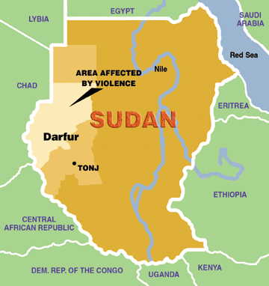
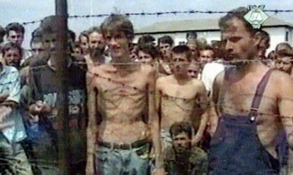
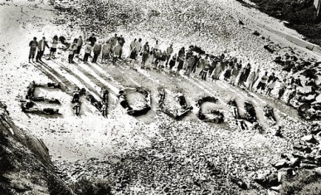
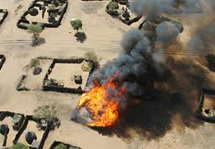
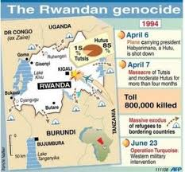
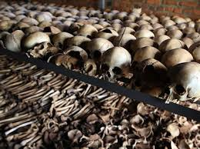
Conflicts continued….
Cut out and glue the visuals into each conflict box that best fits. Make sure there are two pictures per conflict.

Slide 17
Conflict Exit Slip…
How is conflict seen through the eyes of differing cultures?
1 paragraph
Stop

Slide 18
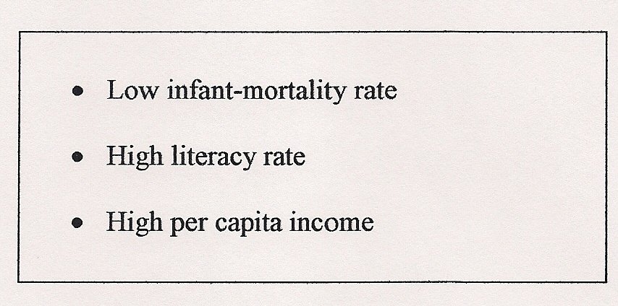
Bell Ringer #7a Development and Standard of Living
The factors listed above describe typical standard-of-living conditions in countries that…
are highly industrialized.
receive large amounts of foreign aid.
are in the process of implementing free-market reforms.
practice subsistence-level agriculture.

Slide 19
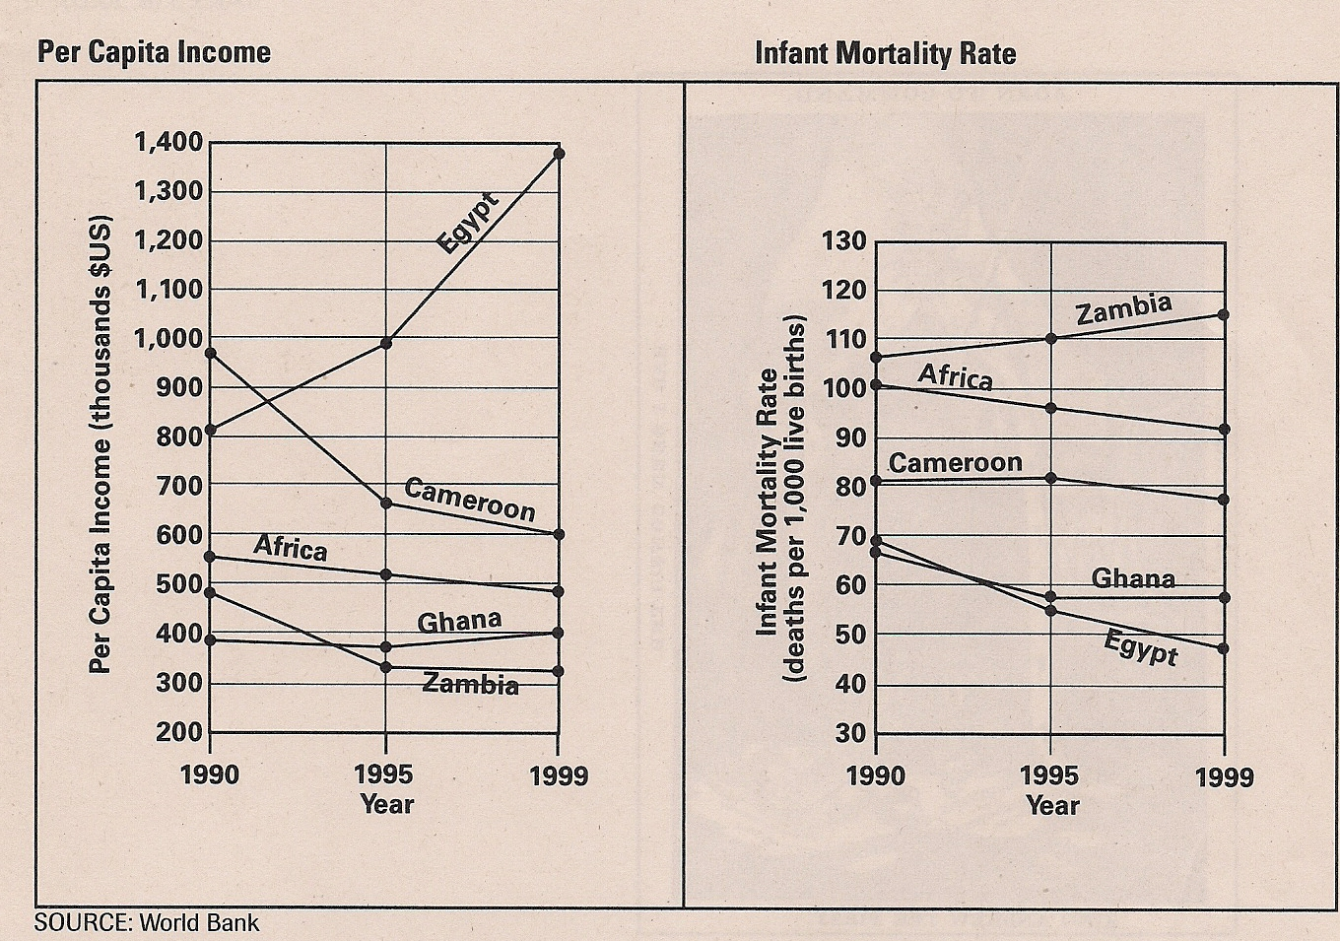
Bell Ringer #7b Development and Standard of Living
Based on per capita income and infant mortality, the most developed country shown on the graphs is-
Ghana
Cameroon
Egypt
Zambia

Slide 20
Day 7- Economics
Essential Questions-
How does a country’s economic situation impact its political relationship with other countries?
How do economic systems, whose activities are affected by globalization, share a relationship with a region’s (or country’s) form of government?

Slide 21
Key Ideas
Concepts-
Globalization, Interdependence, Production,
Vocabulary-
Globalization, Factors of Production, Infrastructure, Standard of Living, Innovations, Free Enterprise, Economic Spectrum, Sectors of Economy
Verbs-
Describe, Explain, Compare, Assess, Examine, Classify, Analyze, Identify, Evaluate

Slide 22
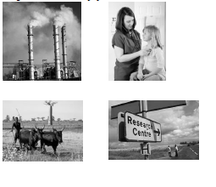
Economics
Cut out the four pictures below and glue them next to the correct economic activity on the chart.
Using what you know about economic activities, determine which level of development is most likely to have this activity (more developed, newly industrialized, or less developed).
Notes:
Teacher Script:
Students will take out prepared maps and student resource packet.
Have students cut out the four pictures and glue them onto the economic activities chat next to the appropriate level.
Discuss with students in which level of development we are most likely to see each of these activities (Levels of development are Less Developed, Newly Industrialized, and More Developed)
Students will cut out Economic activities chart and glue it to the back of their map
Have students brainstorm what they remember about forms of economy. Discuss as a class and have students write correct definitions and characteristics in the box with the name of the economic system
Brainstorm examples of each form of economy
Have students cut out Forms of Economy chart and glue on the back of their map
Use the Development Levels lists to color the top 10 countries green and the bottom 10 countries red
Review Released Test Question #14, 15, 16
Exit Slip: How are less developed countries different from more developed? What patterns do you see?

Slide 23
Economics….
On your economics chart like the one below, write a definition for each form of economy. Determine an example for each form of economy.

Slide 24
What do you notice?
FORMER USSR
CUBA
CHINA
NORTH KOREA
MODERN RUSSIA
SWEDEN
NETHERLANDS
FINLAND
UNITED STATES
GREAT BRITAIN
FRANCE
MONACO
Notes:
http://www.web-books.com/eLibrary/NC/B0/B66/006MB66.html

Slide 25
PRODUCTION METHODS FOR GOOD AND BASIC GOODS
People use different methods to get food and goods to meet their needs.
Description
Subsistence Agriculture Food is mostly consumed by the family
Commercial Agriculture Food is mostly sold to others
Cottage Industry Individual makes goods in his/her home
Commercial Industry Employees come to central location And use company’s equipment/resources

Slide 27
Resources
Cut out these images.
Using classroom resources, look up the main locations for these resources and glue them in the proper regions on your world map.
Oil
Coal
Lumber
Diamonds/
gemstones
Nuclear Power

Slide 28
Oil Reserves

Slide 29
Coal

Slide 30
Timber

Slide 31
Diamonds/Gemstones

Slide 32
Nuclear Energy

Slide 33
Resources
Exit Slip:
How does the location of resources influence the development level of a nation?
Stop

Slide 34
Bell Ringer #8a Principles of the U.S. Constitution
Which of the following is the best example of the principle of limited government in the U.S. Constitution?
All people are granted freedom of religion.
The Constitution identifies powers denied to Congress and the states.
Congress has the power to make laws.
Citizens elect representatives to Congress.

Slide 35
Bell Ringer #8b Principles of the U.S. Constitution
The U.S. Constitution reflects the principle of federalism by stating that…
Powers not delegated to the national government belong to the states or the people.
The government is divided into three branches.
All citizens have the right to equal protection of the law.
All citizens 18 years and older can vote.

Slide 36
Day 8- Government
Essential Questions-
What human and physical factors influence the power to control territory and resources? How can this create conflict/war, and impact international political relations of sovereign nations?

Slide 37
Key Ideas
Concepts-
Conflict, Power, Geographic patterns
Vocabulary-
Power, Conflict, Geographic factors, Physical characteristics, Human characteristics
Verbs-
Analyze

Slide 38
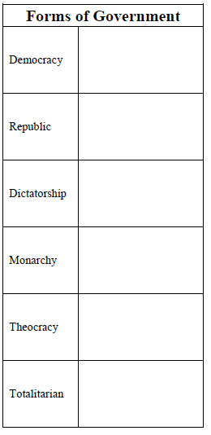
Government
Cut out and match the pictures below and glue them onto
the corresponding Forms of Government chart.
Notes:
Teacher Script
Students will take out prepared maps and student resource packet.
Students will cut out pictures and glue them on the forms of government chart
Lead discussion regarding characteristics of forms of government
Cut out chart and glue it on back of map
Students will brainstorm in groups the roles and responsibilities of supranational organizations.
Have students fill out chart and then glue it to the back of their map.
Review Released Test Question # 2, 3, 45

Slide 39
Organizations/Agreements
Title | Type | Description
United Nations (UN) | Political | committed to maintaining international peace and security, developing friendly relations among nations and promoting social progress, better living standards and human rights
European Union (EU) | Economic/ Political | unification of 27 member states united to create a political and economic community throughout Europe
Organization of the Petroleum Exporting Countries (OPEC) | Economic | 14 countries that contain the most petroleum (oil) and set the price around the world
North American Free Trade Agreement (NAFTA) | Economic | Agreement between US, Canada, and Mexico to allow free trade between countries- led to development of maquiladoras
Association of Southeast Asian Nations (ASEAN) | Political/ Economic | 10 members whose goal includes accelerating economic growth, social progress, cultural development among its members
North Atlantic Treaty Organization (NATO) | Political | Began in 1949, it was meant to stop communism from spreading into war-torn western Europe after WWII; Recently invaded Afghanistan because US was attacked

Slide 40
Your map should be starting to look like this….

Slide 41
Jeopardy
Government/
Economics
Stop

Slide 42
Day 9
Choose one of the following and complete

Slide 43
Development Profiles
The task: Create a poster that symbolizes the characteristics of your assigned level of development. Be sure to include a world map that indicates the regions of the world that fit your assigned level of development.
Have students share out with the class.
Exit slip: What are the similarities and differences between levels of development?
Notes:
Place students in small groups
Assign each group a level of development

Slide 44
Regional Profiles
The task: Create large map of the region you were assigned. Add symbols, pictures, and words to the map so that it reflects the many facets of the region.
Have students share out with the class
Notes:
Place students in small groups
Assign each group a region of the world: Latin America, North America, Africa, Middle East, Europe and Russia, East Asia, South Asia, Southeast Asia, Australia and Antarctica

Slide 45
Patterns
The task: Student will create a presentation that explains how their assigned top applies to the world.
The presentation can be in any format you choose. (i.e. students might create a rap describing how imperialism has impacted the different regions of the world)
Notes:
Place students in small groups
Assign a topic/concept to each group: Imperialism, Nationalism, Pandemics, etc

