Slide 1
RUSSIA
Geography

Slide 2
Major Geographic Features
Larges country in the world
Former colonial power
Population and development concentrated in the west (west of Ural Mountains).
Culturally diverse, but dominated by the Russian culture.
Ports are limited due to climate/ice.

Slide 3
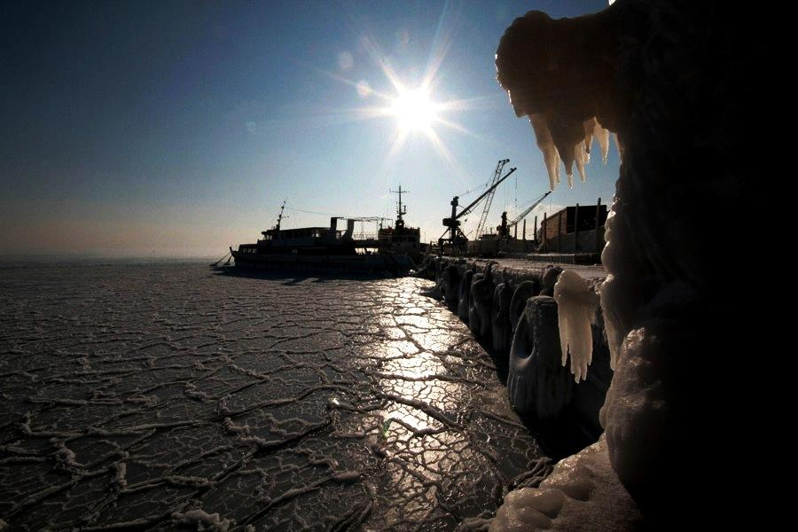

Slide 4
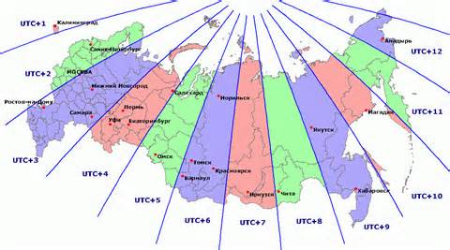
Dimension
Spans 11 Time Zones
From East to West: Gulf of Finland to Alaska
From North to South: Above the Arctic Circle to Salt Lake
Twice the size of the United States

Slide 5
Russia’s Regions
RUSSIAN PLAIN
  EASTWARD CONTINUATION OF NORTH EUROPEAN PLAIN
  CORE AREA (MOSCOW)
URAL MOUNTAINS
  2,000 MILES LONG (NORTH-SOUTH)
  SOURCE OF MINERALS
WEST SIBERIAN PLAIN
  WORLD’S LARGEST LOWLANDS
  PERMAFROST

Slide 6
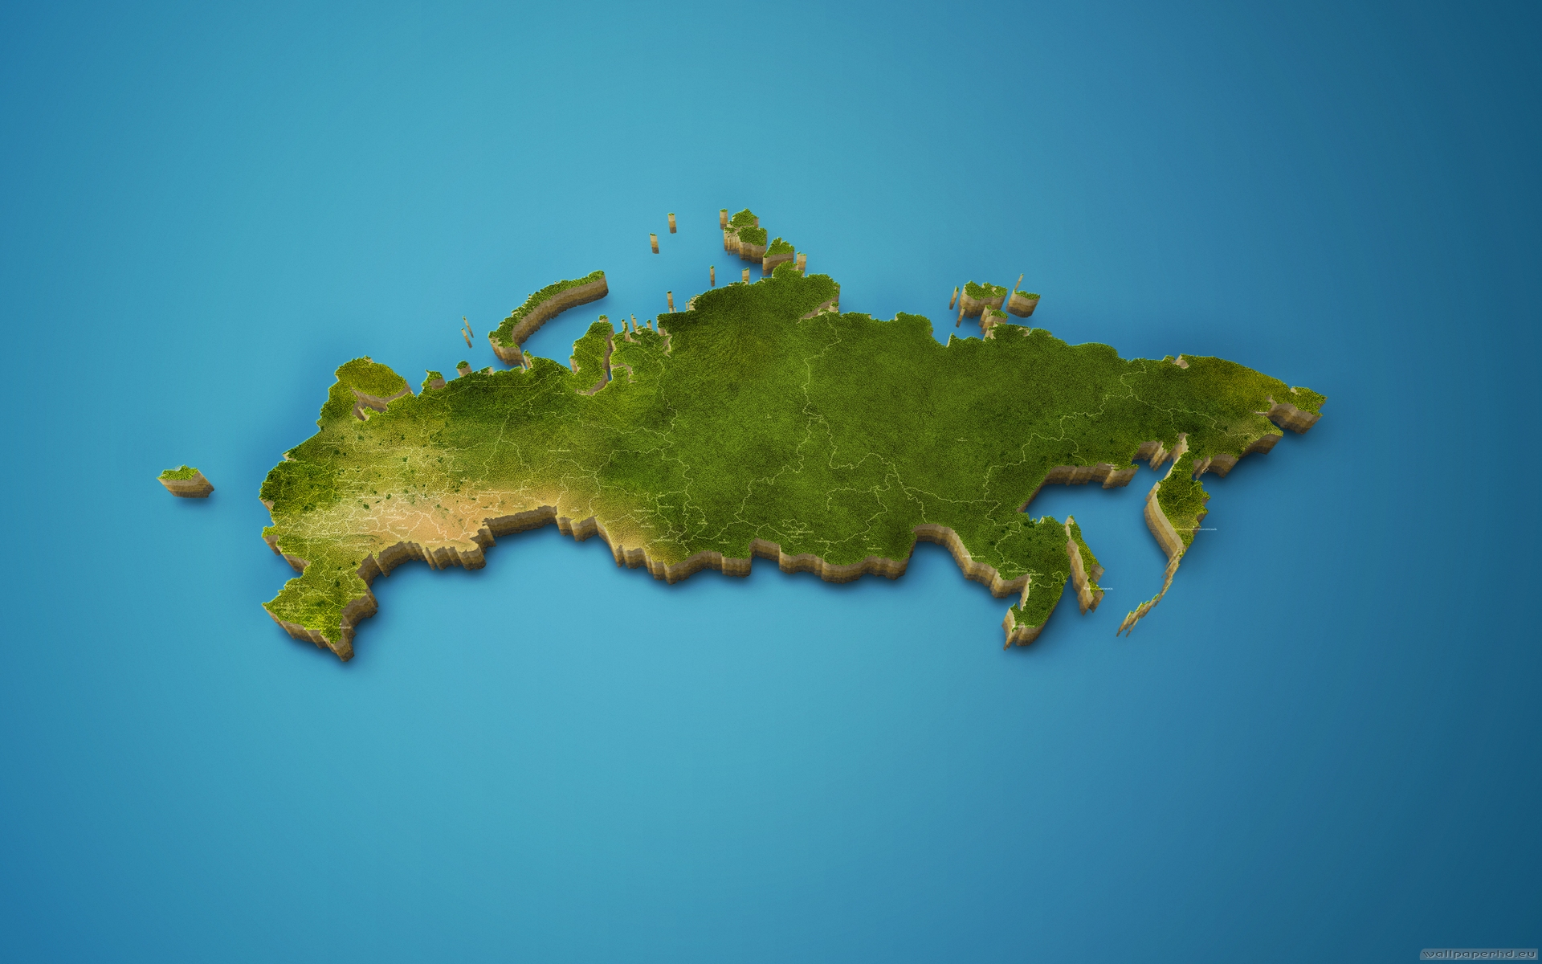
Regions of Russia
Europe
Pacific Ocean
U
R
A
L
S
Siberia
Russian Plains

Slide 7
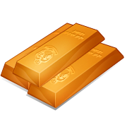

Ural Mountains
NORTH-SOUTH LENGTH COVERS 2000 MILES
CENTRAL URALS ARE THE LOWEST SECTION AND INCLUDE SEVERAL KEY CROSSING PLACES
URAL FORESTS AND MINERALS HAVE BEEN THE SOURCE FOR INDUSTRIALIZATION
SOURCE OF AT LEAST TWENTY DIFFERENT COMMERCIALLY USABLE MINERALS

Slide 8
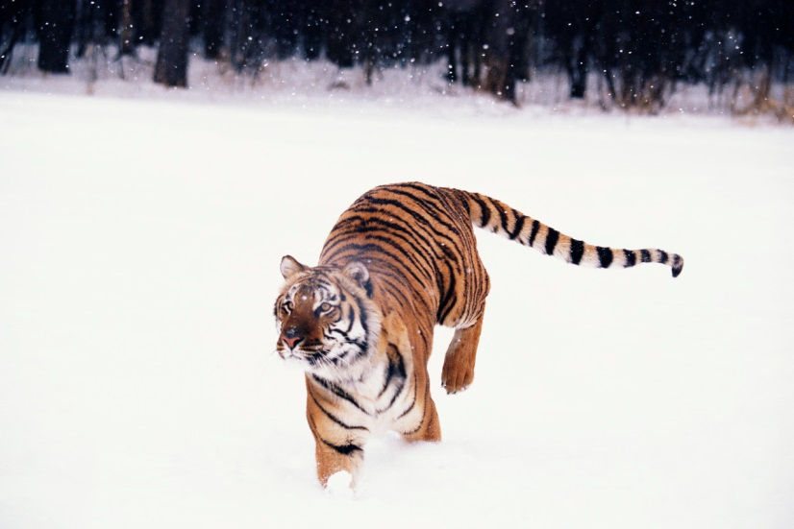
Siberian Plain
THE WORLD’S LARGEST CONTINUOUS LOWLAND
INCLUDES SEVERAL MAJOR RIVER BASINS
SPARSELY SETTLED
LIMITED ACCESS
RESTRICTIVE CLIMATE
PERMAFROST

Slide 9
Restrictive Climate
AGRICULTURE
  SHORT GROWING SEASONS
  EROSION (ACCELERATED VIA SNOW MELT)
SETTLEMENT PATTERNS & TRANSPORTATION (limited)
INDUSTRY
  HIGH ENERGY CONSUMPTION (for heat)
  EXTRACTION (more expensive in permafrost)

Slide 10
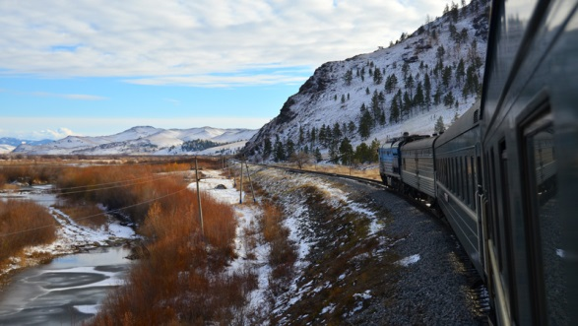
Trans-Siberian Railroad

Slide 11
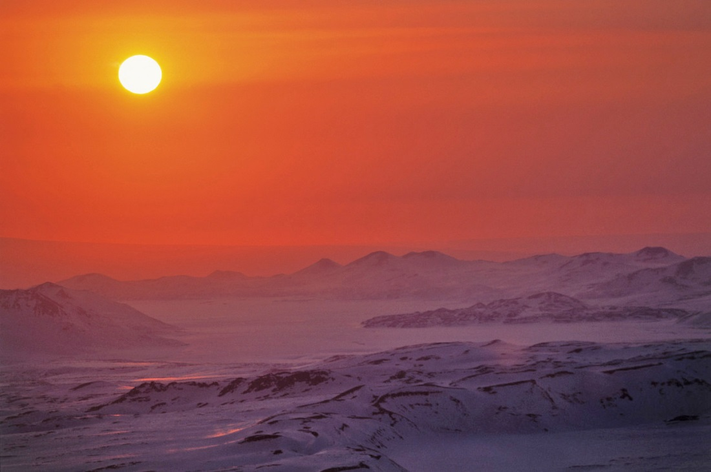
Siberia
LARGER THAN THE U.S., LESS THAN 15 MILLION PEOPLE
CHALLENGING ENVIRONMENT
  DISTANCE
  COLD TEMPERATURES
  ARCTIC WINDS
  POOR SOILS
RESOURCE POTENTIAL
  PRECIOUS MINERALS
  METALLIC ORES
  OIL AND NATURAL GAS
  TIMBER

Slide 12
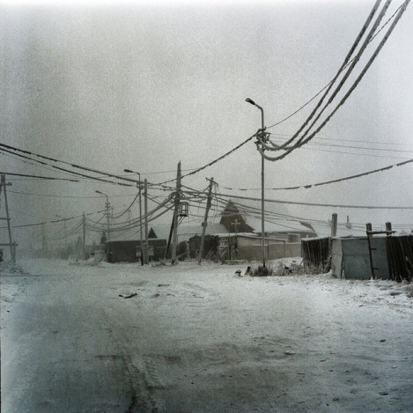
Yakutsk, Siberia
What is the temperature today?
http://www.bing.com/weather/search?q=Yakutsk%20temp&unit=F&qpvt=Yakutsk+temp&FORM=DTPWEA

