Slide 1
3 Major India Religions: Hinduism, Buddhism, & Sikhism
Dharma can mean a lot of things, including Natural Law, Social Order, Right Conduct, and Virtue. It forms the basis for philosophies and beliefs originating in India, including Hinduism, Buddhism, and Sikhism … In these traditions, beings that live in harmony with Dharma proceed more quickly toward personal liberation (nirvana).

Slide 2
Hinduism

Slide 3

What is Hinduism?
One of the oldest religions of humanity
The religion of the Indian people
Gave birth to Buddhism, Jainism, Sikhism
Tolerance and diversity: "Truth is one, paths are many"
Many deities but a single, impersonal Ultimate Reality
A philosophy and a way of life – focused both on this world and beyond

Slide 4
How did Hinduism begin?
No particular founder
Indus River Valley Civilization >5000 years ago
Aryans enter 4000 - 3500 years ago
2800 – 2400 yrs ago, part of the Vedas. Vedic tradition develops into Hinduism

Slide 5
What are the Sacred Texts?
Four Vedas (“truth”) – myths, rituals, chants
Oldest sacred text of Hinduism (similar to the Bible). It’s used to recite prayers and its read at religious functions.
Upanishads -Part of the Vedas. Discuss the nature of God, meditation and philosophy.
Mahabharata- A poem explaining karma, human goals and Moksha (liberation).
  1.8 million words- the longest epic poem in the world

Slide 6
What do Hindus believe?
One impersonal Ultimate Reality – Brahman
True essence of life – Atman, the soul, is Brahman trapped in matter (“That art thou”)
Reincarnation (rebirth) – atman is continually born into this world lifetime after lifetime (Samsara)
Karma – spiritual impurity due to actions keeps us bound to this world (good and bad)
Goal of life – to release Atman & reunite with the divine, becoming 1 w/Brahman (Moksha)

Slide 7
How does Hinduism direct life in this world?
Respect for all life – vegetarian
Human life as supreme:
  4 “stations” of life (Caste) - priests & teachers, nobles & warriors, merchant class, servant class- untouchables
  4 stages of life – student, householder, retired, renunciant
  4 duties of life – pleasure, success, social responsibilities, religious responsibilities (moksha)

Slide 8
The Cast System
The caste system in India can be described as an elaborately stratified social hierarchy distinguishing India’s social structure from any other nation.
--The varna of Brahmans, commonly identified with priests and the learned class
--The varna of Kshatriyas, associated with rulers and warriors including property owners.
--The varna of Vaishyas, associated with commercial livelihoods (i.e. traders)
--The varna of Shudras, the servile laborers

Slide 9
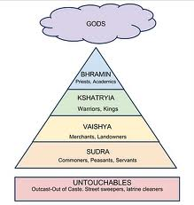

Slide 10
What are the spiritual practices of Hinduism?
The 4 Yogas - seeking union with the divine:
  Karma Yoga – the path of action through selfless service
  Jnana Yoga – the path of knowledge (understand the nature of reality & the self)
  Raja Yoga – the path of meditation
  Bhakti Yoga – the path of devotion
Guru – Spiritual teacher (for Jnana & Raja)
It provides insight into the nature of existence

Slide 11
How do Hindus worship?
Bhakti Yoga is seeking union w/the divine through loving devotion to manifest deities
    In the home (household shrines)
    In the Temples (priests officiate)
  Puja – making offerings to and decorating the deity images
  Darsan – “seeing” the deity (not idol worship)
  Prasad – taking the divine w/in your own being by eating food shared with the deity

Slide 12
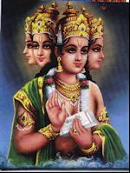
Who do Hindus worship? – the major gods of Hindu Pantheon
Brahma, the creator god

Slide 13
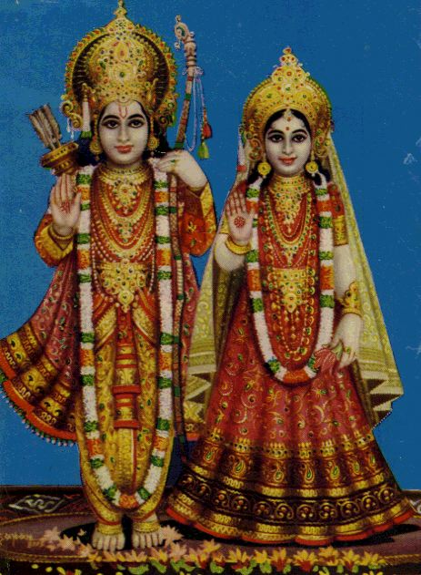
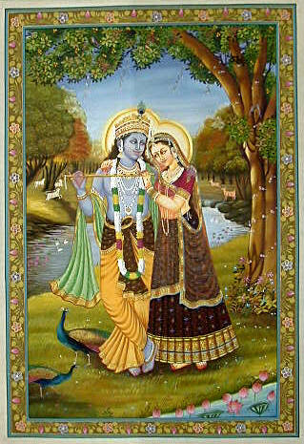
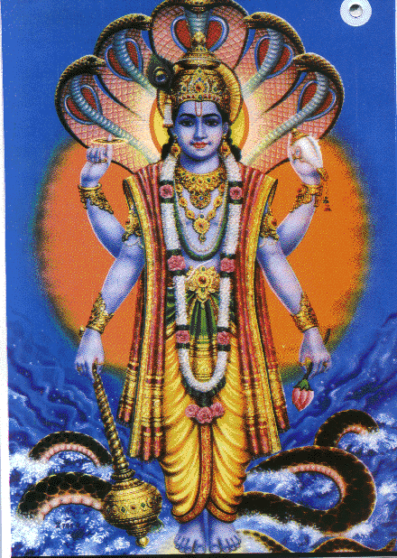
Who do Hindus worship? – the major gods of Hindu Pantheon
Vishnu, the preserver god
Rama (featured in the Ramayana)
Krishna (featured in the Mahabharata)

Slide 14
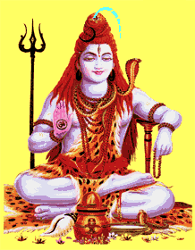
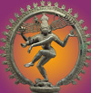
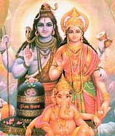
Who do Hindus worship? – the major gods of Hindu Pantheon
Shiva, god of constructive destruction
(the transformer)
Appears as Shiva Nataraj,
lord of the dance of creation…
  & his wife, Parvati, & son Ganesha
  (elephant headed-remover of obstacles)

Slide 15
What about the goddesses?
Devi – the feminine divine
Saraswati, goddess of wisdom, consort of
Brahma
Lakshmi, goddess of good fortune, consort
of Vishnu
Parvati, divine mother, wife of Shiva
Durga, protectress
Kali, destroyer of demons
Plus about 330 million other deities

Slide 16
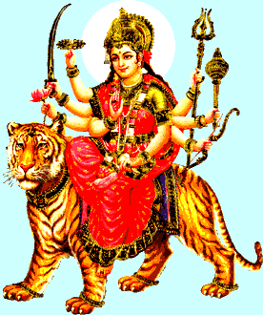
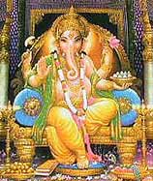
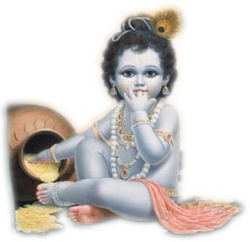
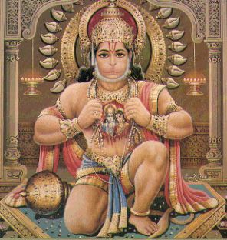
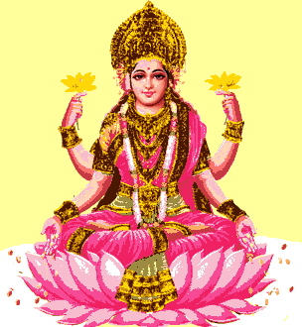
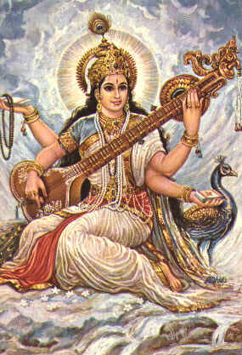
All these deities are but
Manifest forms (attributes
and functions) of the
impersonal Brahman

Slide 17
And we too are manifest forms of God!
“We are not human beings
having spiritual experiences;
We are spiritual beings
having a human experience!”

Slide 18
Buddhism

Slide 19
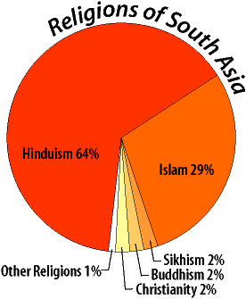
Religions of South Asia

Slide 20

Buddhism…
The “middle way of wisdom and compassion”
A 2500 year old tradition (founded in 500BC) that began in India and spread and diversified throughout the Far East
A philosophy, religion, and spiritual practice followed by more than 300 million people
Based on the teachings of the Buddha
Buddhists don’t care about the creation of the world- it doesn’t matter to them.

Slide 21

Who was the Buddha?
Born Siddhartha Gautama – of noble caste in India, 563 B.C.E. in great luxury to be a king
Empathy for the suffering of others; at age 29 rejected the life of luxury to seek enlightenment and the solution to suffering
Followed a strict ascetic lifestyle for six yrs
Sat in meditation, achieved Nirvana – an awakening to the truth about life, becoming a Buddha, the “Awakened One”at the age of 35
Spent remaining 45 years of his life teaching others how to achieve the peace of mind

Slide 22
Basic Beliefs
Purpose of life is to develop compassion for all living beings and to work for their good, happiness, and peace; and to develop wisdom leading to the realization of Ultimate Truth.
There is no almighty God in Buddhism.
In Buddhism, the primary purpose of life is to end suffering. The Buddha taught that humans suffer bc we strive after things (friends, health, material wealth) that do not last or give lasting happiness causing sorrow.

Slide 23
What is the fundamental cause of all suffering?
Desire!
Therefore, extinguish the self, don’t obsess about oneself.

Slide 24

What did the Buddha teach?
The Four Noble Truths
To live is to suffer
The cause of suffering is self-centered desire & attachments
The solution is to eliminate desire and attachment, thus achieving Nirvana (“extinction”). Nirvana is ultimate spiritual reality, an escape f/ the cycle of rebirth.
The way to Nirvana is through the “Eight-Fold Path”

Slide 25
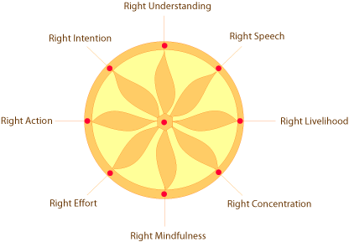
Four Noble Truths: The Eightfold Path to reach Nirvana

Slide 26
The Afterlife
According to Buddhism, after death one is either reborn into another body (reincarnated) or enters nirvana.
Only Buddhas - those who have attained enlightenment (nirvana) - will achieve the latter destination.

Slide 27
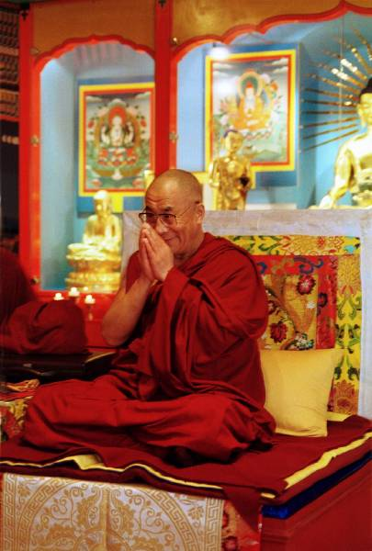
The
Dalai
Lama
Tibet’s Spiritual Leader

Slide 28
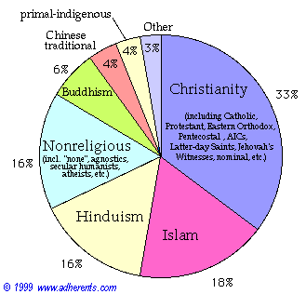
Buddhism in America (1999)

Slide 29
Recap: Buddhism Characteristics
Reincarnation
Siddartha Gautama (Founder)
Four Noble truths
Eightfold Path

Slide 30
How does Buddhism differ from Hinduism?
Buddhism rejects…
Authority of the ancient Vedic texts
The Vedic caste system
The Vedic and Hindu deities
The efficacy of Vedic worship and ritual
The concept of Brahman

Slide 31
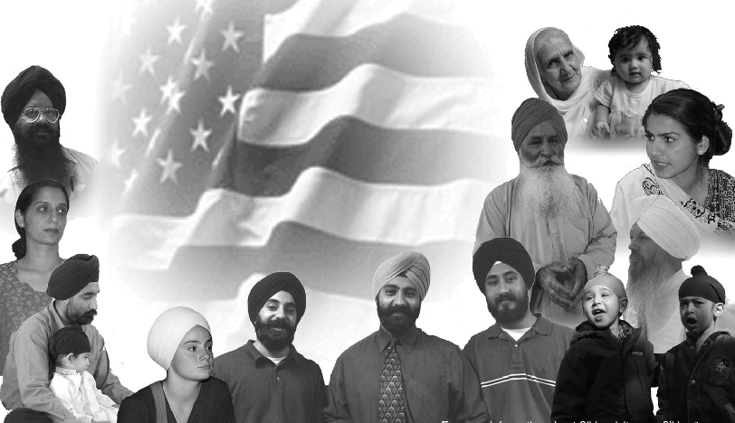
SIKHS
Notes:
I would like to thank you for giving us the opportunity to share a little about our background as Sikh Americans. With the recent attacks on September 11, Sikh Americans have also been shocked and share in the pain with other fellow Americans during these tragic events. As a result of the current events in the world, there have been a lot of questions as to who not only Sikhs are, but various other religions and cultures from around the world.
As Sikh-Americans, we have decided to take a proactive step by informing our fellow Americans and neighbors exactly who Sikhs are and what the founder of our faith believed in, in an attempt to enhance awareness and decrease ignorance.

Slide 32
Sikhism in Brief
Sikhism is an independent religion
23 million Sikhs worldwide
  500,000 Sikhs reside in the United States and 500,000 Sikhs live in Canada
Sikhs came to North America in late 1800s, more than a hundred years ago
Notes:
In sheer numbers, fifth largest religion.
Approximately 500,000 in the US.

Slide 33
Core Sikh Beliefs
There is One God for all of creation, a loving Creator attainable through Grace.
Reincarnation
All human beings are created equal. Women have complete equality with men.
Live a moral, truthful, hardworking existence.
Selfless service towards the entire Creation.
Defending the rights of the downtrodden and oppressed.

Slide 34
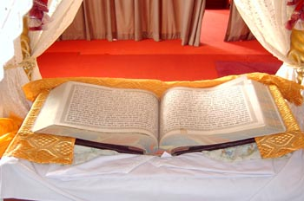
Guru Granth Sahib:
Sikh Scripture
Founder
Was compiled by the Sikh prophets during their lifetime
Compilation of divine wisdom, thanks, prayer
It is poetry
Sikh services consist of singing and an explanation of the Sikh Scriptures

Slide 35
Three Staples of Daily Life
Kirat Karo: work hard and honestly
Vand Chako: share what you have with the needy
Naam Japna: always remember God throughout the day

Slide 36



Articles of Faith
Mandatory articles of faith for all initiated Sikhs
Kesh – Uncut hair
Kirpan – Religious sword
Karra – Steel bracelet
Kangha – Wooden comb
Kachehra – Boxer shorts
Kirpan
Karra
Kangha

Slide 37
Kirpan
Mandatory article of faith revealed to tenth Sikh Prophet by God.
Sikhs wearing it since the year 1699.
Not a weapon and not a mere symbol.
Generally worn under clothing.
Reminds Sikhs to fight against injustice and oppression at all times.

Slide 38

Dastaar – the Turban
A mandatory article of faith for Sikhs.
Symbolic of sovereignty bestowed by God, since each individual is equal in the eyes of God.
Sikhs have been wearing it for the last 500 years.
Under no circumstances can the turban be forcibly removed.
Removal of turban in public is tantamount removing someone’s trousers.

Slide 39
Common Misconception
Fiction: Sikhs are Muslim because they wear a dastaar (turban) and have a beard
Fact: Turbans are worn in many countries as a cultural dress however the turban is required to be worn by a Sikh in order to cover their uncut hair and is a religious article of faith. 99% of people wearing turbans in the United States and Canada are Sikhs.

Slide 40
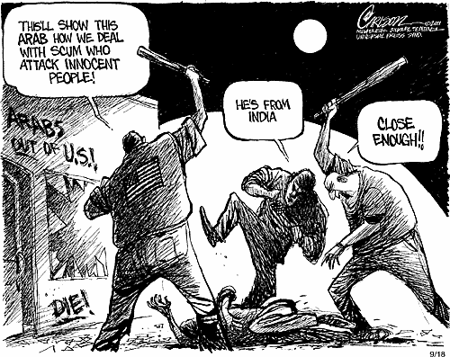
Challenges Today…..
Notes:
Open to the audience what challenges they think Sikhs face in USA today?
The nexy few slides are about real incidents of racism and hate crimes which were reported to the Sikh Coalition.

