Slide 1
Population Pyramids
World Geography

Slide 2
Population Pyramid
A population pyramid, also called an age structure diagram, is a graphical illustration that shows the distribution of various age groups in a population (typically that of a country or region of the world), which forms the shape of a pyramid when the population is growing.

Slide 3
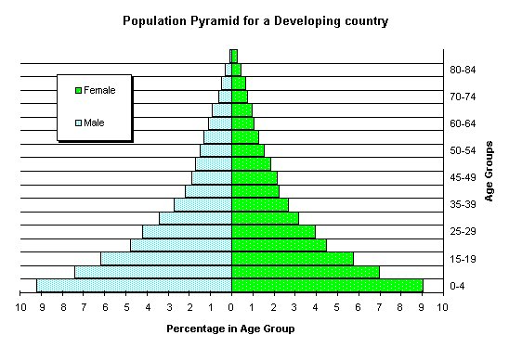
Population Pyramid

Slide 4
Population Pyramids
Male/ Female
Age
Percentage of overall population

Slide 5
Population Pyramid
Why does a country want to know how many Males & Females they have?
Why is it important?

Slide 6
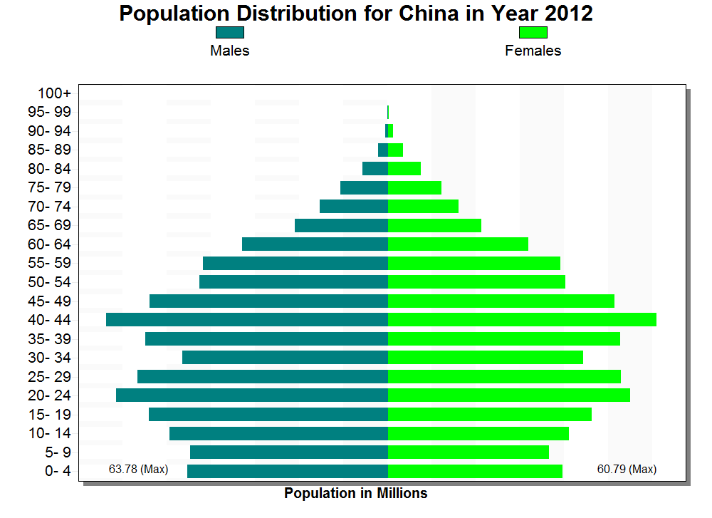
Population Pyramid

Slide 7
Population Pyramid
Why does a country want to know the ages of there population?
Why is it important?

Slide 8
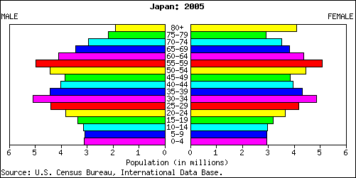
Population Pyramid

Slide 9
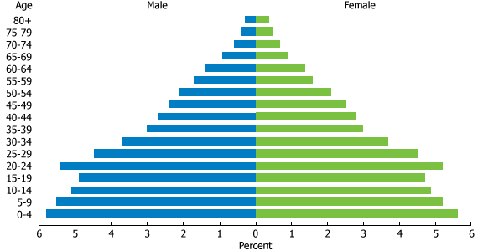
Egypt Population Pyramid

Slide 10
Population Pyramids
Why do Geographers want to have this type of information?

