Slide 1
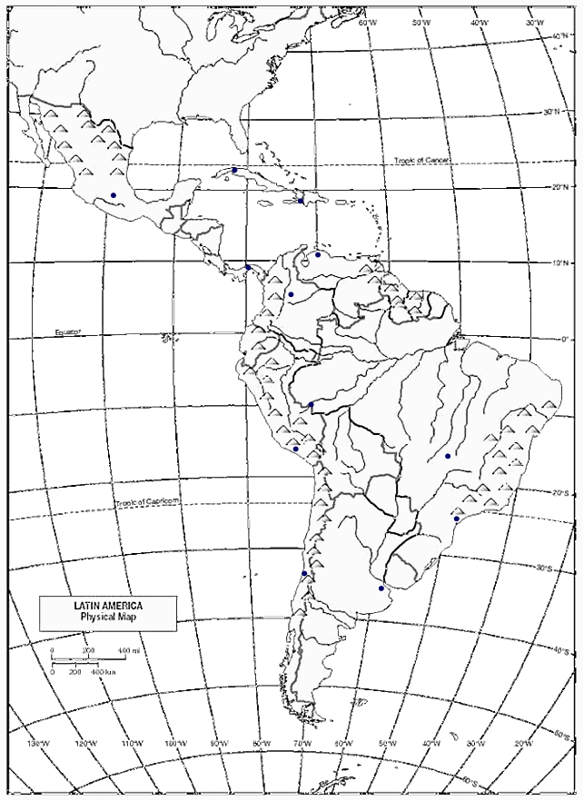
Deserts
Atacama Desert

Slide 2
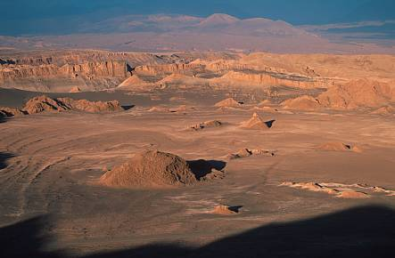
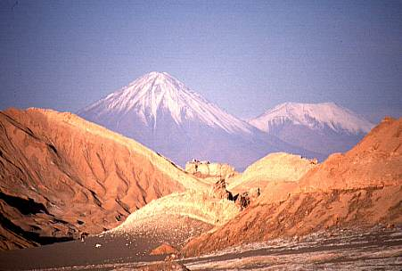
Atacama Desert

Slide 3
Cities
Havanna
Mexico City
Port-au-Prince
Caracas
Panama City
Bogota
Lima
Brasilia
Rio De Janiero
Santiago
Buenos Aires

Slide 4
Others
Panama Canal
Falkland Islands
Cape Horn

Slide 5
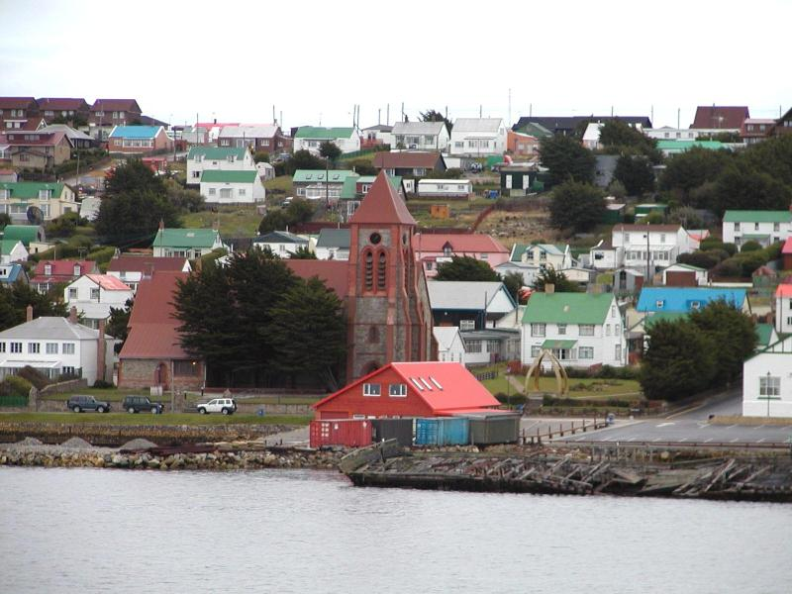
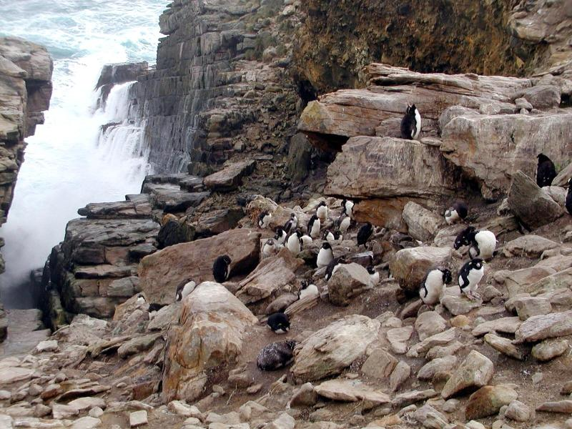
The Falkland Islands or Islas Malvinas

Slide 6
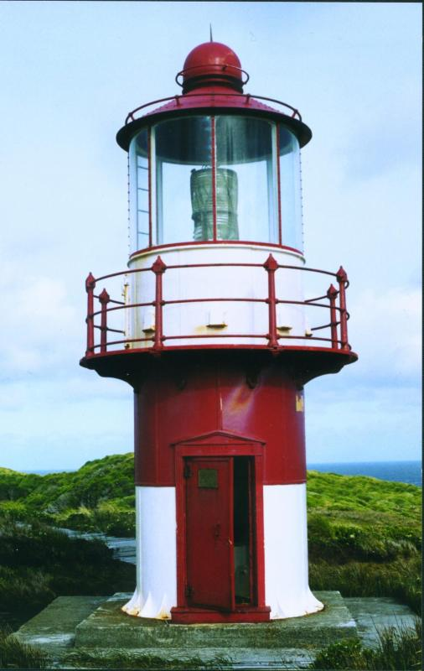
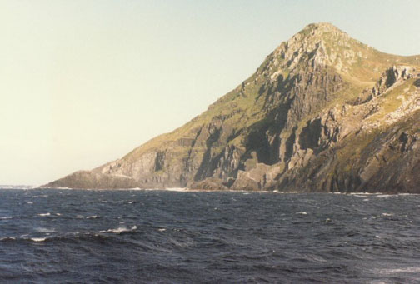
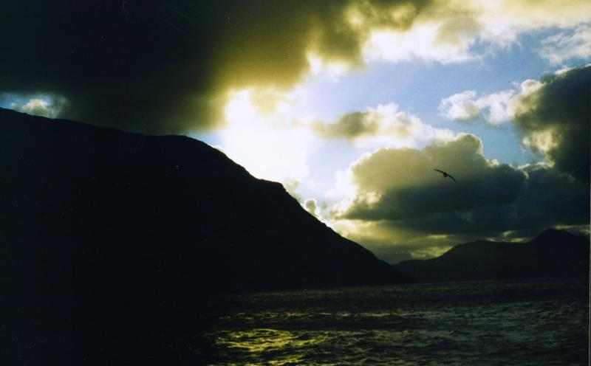
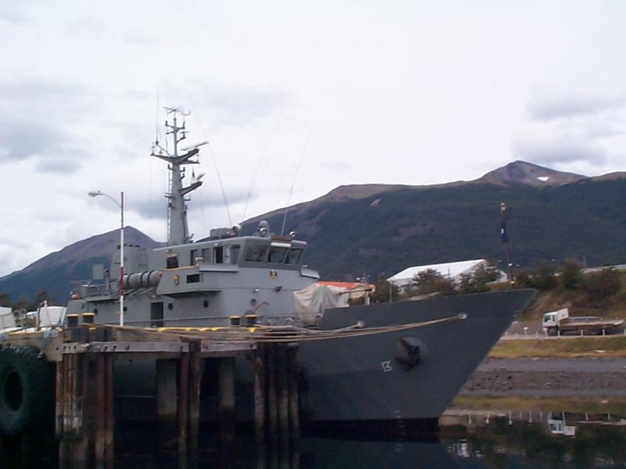
Cape Horn

Slide 7
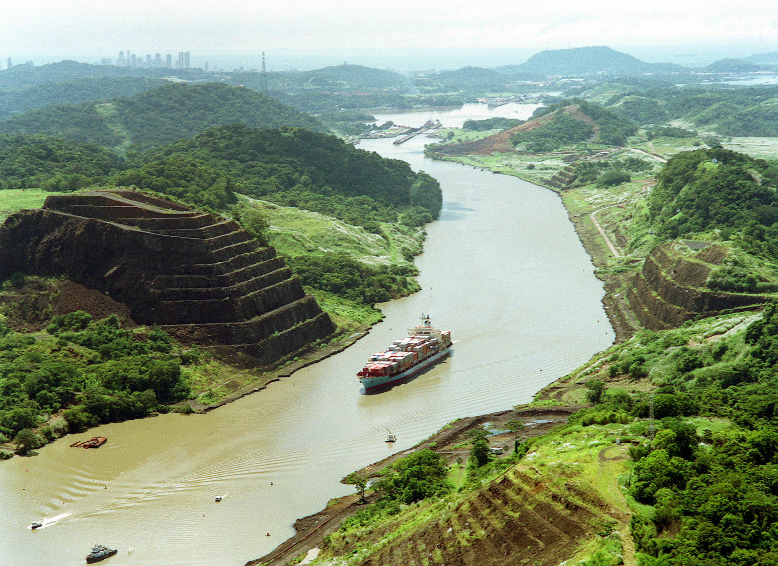
The Panama Canal

Slide 8
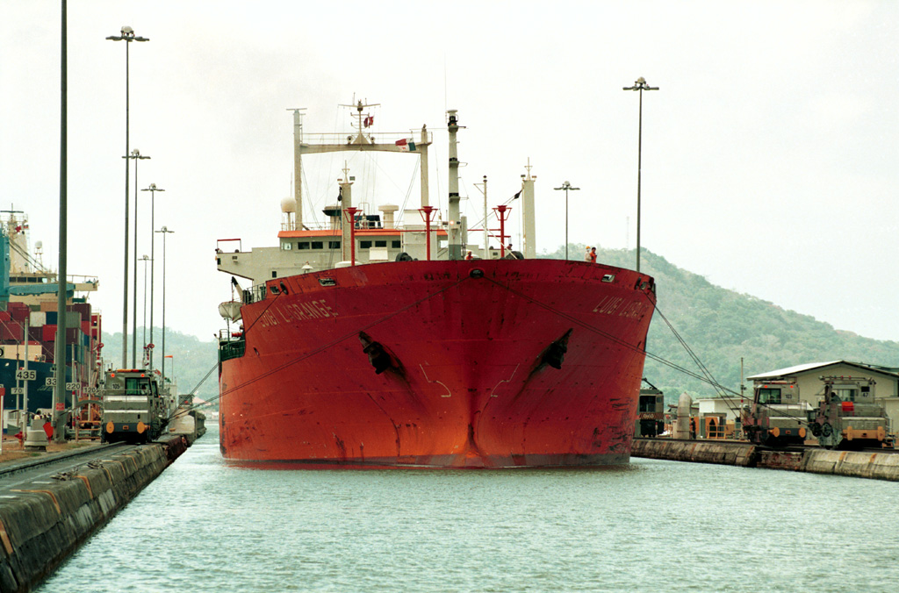
Going Through the Panama Canal

Slide 9
Sierra Madres Mts.
Gulf of Mexico
Havanna
Mexico City
Port-au-Prince
Caribbean Sea
Lake Maracaibo
Caracas
Panama City
Orinoco R.
Panama Canal
Llanos
Magdalena R.
Bogota
Guiana Highlands
Amazon R.
Pacific Ocean
Amazon Basin
Sao Francisco R.
Mato Grosso
Andes Mts.
Lima
Brasilia
Brazilian Highlands
Gran Chaco
Lake Titicaca
Parana R.
Rio De Janiero
Atacama Desert
Uruguay R.
Santiago
Pampas
Buenos Aires
Rio de La Plata
Patagonian Plateau
Falkland Islands
Atlantic Ocean
Cape Horn

Slide 10
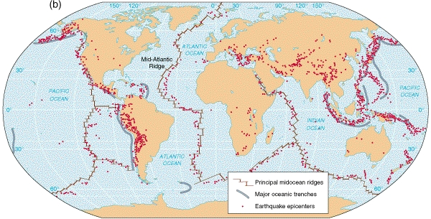
Earthquake Zones

Slide 11
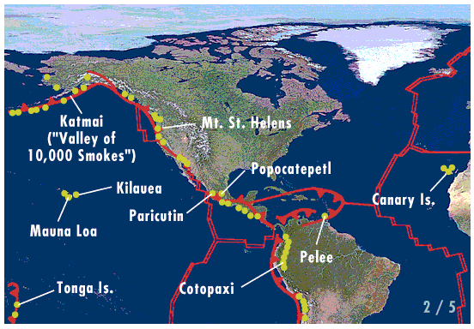
Active Volcanoes

Slide 12
Climate

Slide 13
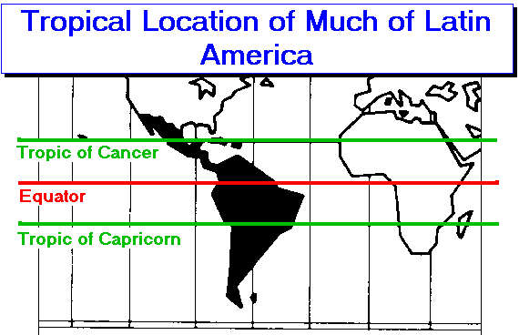
The Tropical Hemisphere

Slide 14
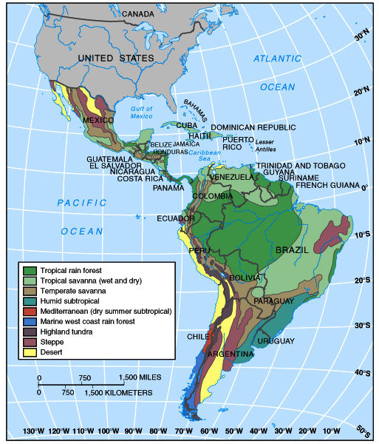
Latin
American
Climatic
Zones

Slide 15
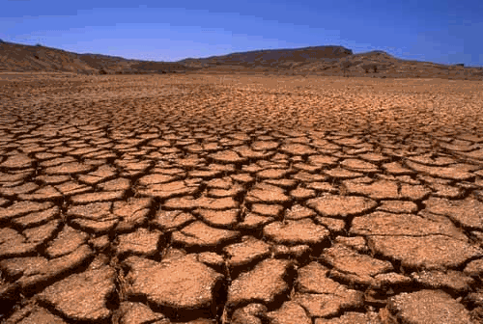
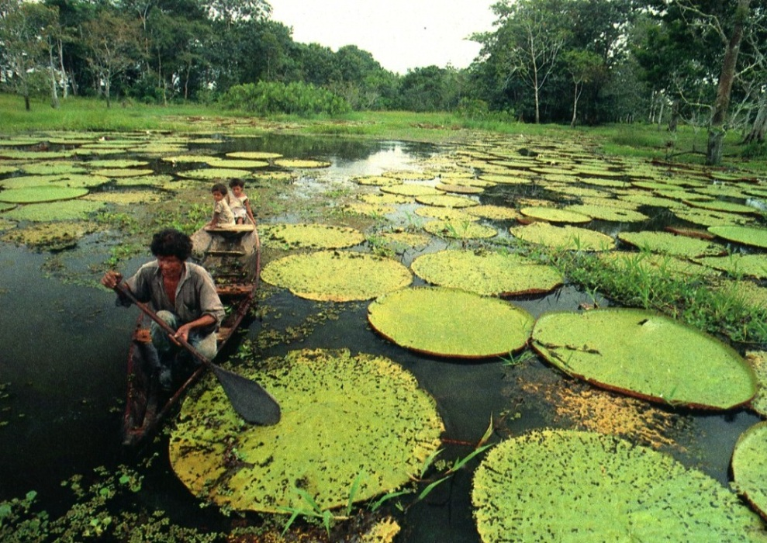
Very Varied Climate Zones

Slide 16
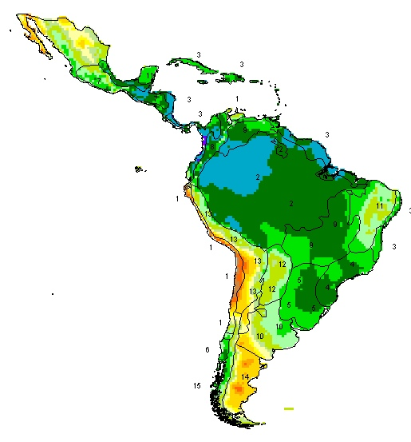
Precipitation

Slide 17
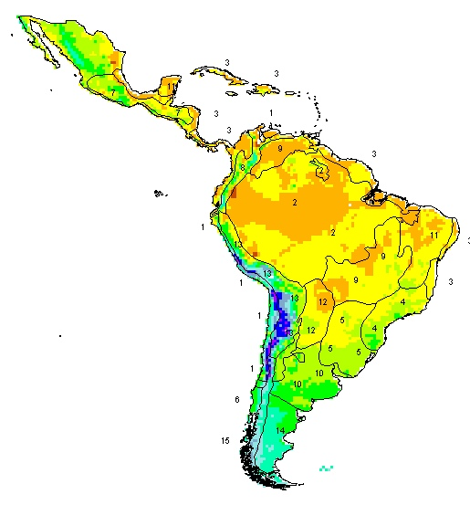
Temperatures

Slide 18
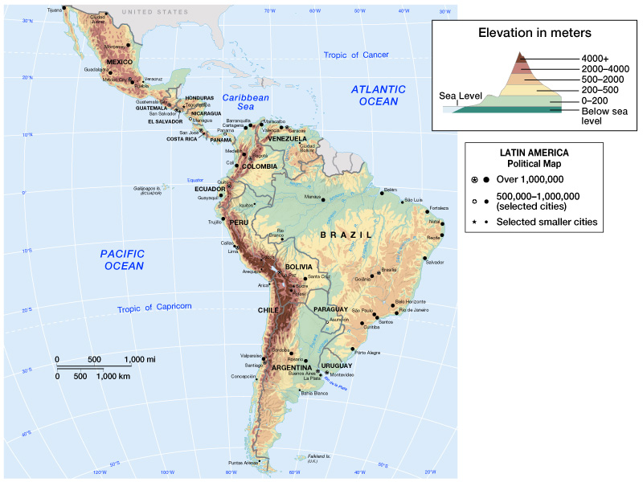
Elevation

Slide 19
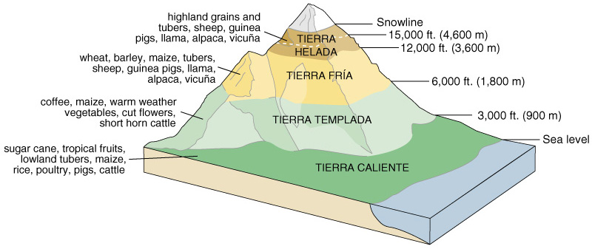
Altitudinal Zonation: Vertical Climate

