Slide 1
History and Government of East Asia

Slide 2
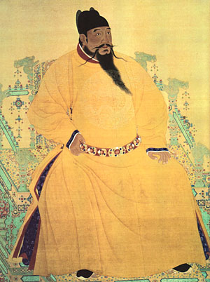
Ancient East Asia
China oldest continuous civilization
Became regions culture hearth-center from which ideas and practices spread to other areas
Eventually ruled by a dynasty- ruling family

Slide 3
Korea and Japan
Chinese settlers brought culture to neighboring Korea
Buddhism spread from China to Korea
Korean Peninsula became a cultural bridge between China and Japan
China and Korea had major impact on Japanese civilization

Slide 4
Modern East Asia
Years of civil war bring communists into power in 1948
Set up Peoples Republic of China
Pressure to modernize opens China’s economy to free-market influences

Slide 5
Modern Japan
Used diplomacy and military force to build an empire that included Taiwan and Korea
After its defeat in World War II it became a democracy
Has emerged as a global economic power

Slide 6
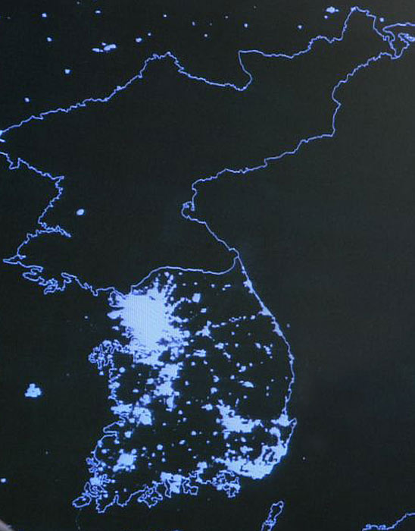
North and South Korea
After World War II ended Korea was divided because of military conflict
American backed South Korea
democracy
Communist backed North Korea
Cannot meet peoples most basic needs

Slide 7
East Asian Governments
Communist State-is a revolutionary socialist movement to create a classless, moneyless, and stateless social order structured upon common ownership of the means of production. Leadership through ONE person or One party that IS NOT democratically elected
_{Example: China, North Korea}
Constitutional Monarchy- a form of government in which a monarch acts as head of state within the parameters of a constitution,
Democracy-the people, or some significant portion of them, retain supreme control over the government.
Example: Japan, South Korea, Mongolia, Taiwan

