Slide 1
Map to the STAARs

Slide 2
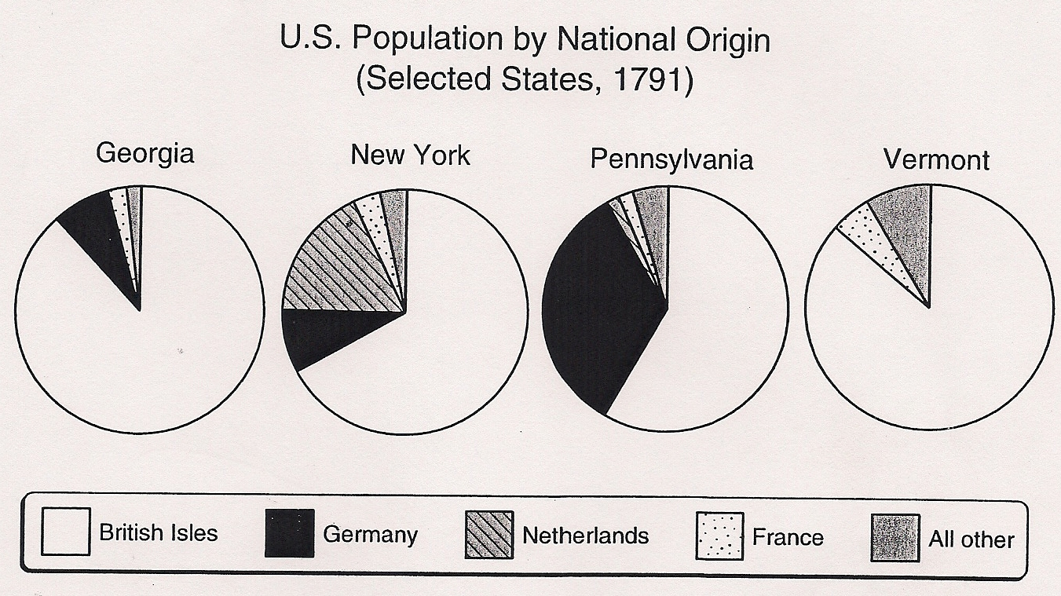
Bell Ringer # 1a Geographic Distributions
Which of these states had the largest percentage of people from Germany?
Pennsylvania
New York
Georgia
Vermont

Slide 3
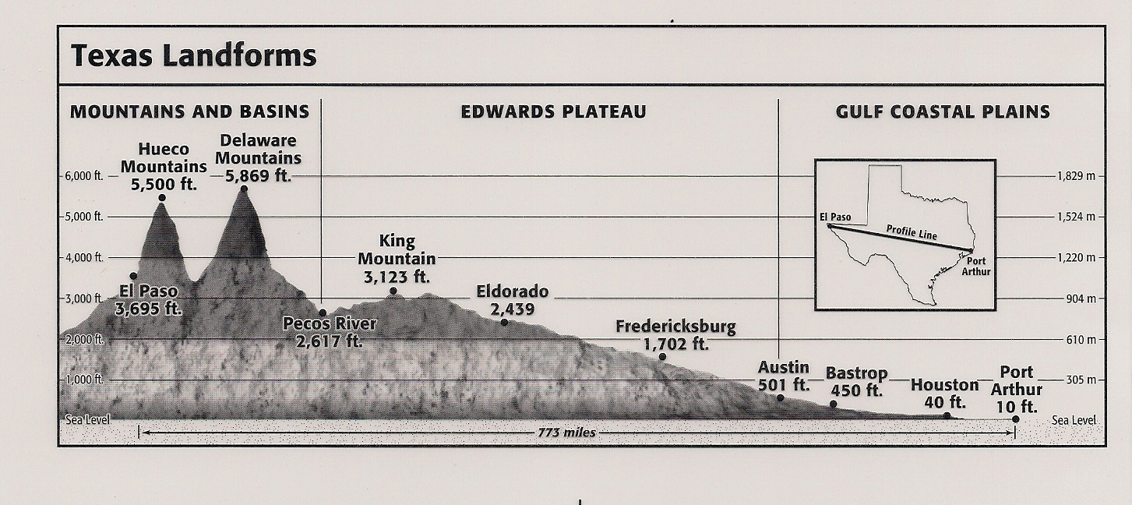
Bell Ringer #1b Geographic Distributions
According to the graph above, which part of Texas has the lowest elevation?
East
West
North
South

Slide 4
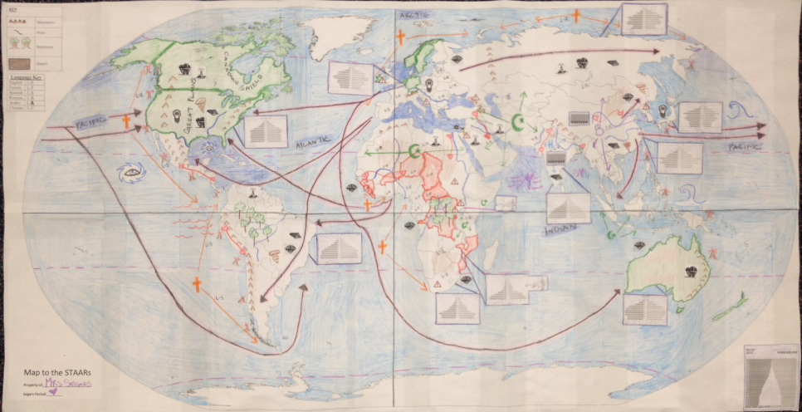
World Geography EOC Review
Below is an example of what your map will look like when we are complete.

Slide 5
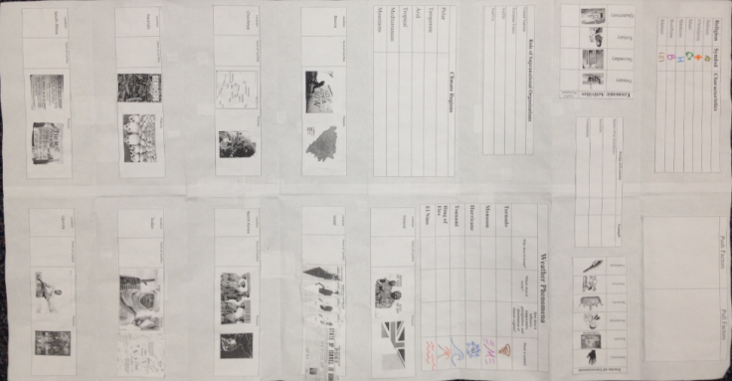
Your Map will include items on the back …
We will process significant information on the back of your map.

Slide 6
Day 1- 5 Themes
Essential Question-
How can maps be used to explain the division of land, including man-made and natural borders, into separate political units such as cities, states, or countries?

Slide 7
Key Ideas
Concepts-
Location, Place, Human-Environment Interaction, Movement, Regions
Vocabulary-
Absolute Location, Distortion, Map Projection, Relative Location
Verbs-
Describe, Explain, Compare, Analyze, Identify, Evaluate

Slide 8
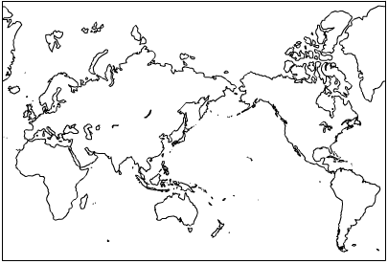
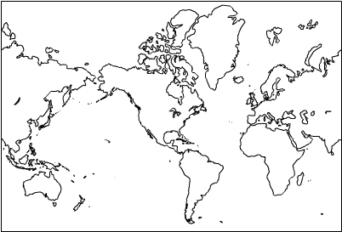
Map Perspectives

Slide 9
More Map Perspectives

Slide 10
Physical Features
Cut out maps and tape together starting with center pieces
You will begin to fill out physical features on each continent according to the physical features page of the resource packet.
Name, Period- Northeast corner
Glue key to Northwest corner of map
Draw compass in Southwest corner
Notes:
Teacher Script
Students will take out prepared maps
Give each student a resource packet and have them put their names on them.
Students will begin to fill out physical features on each continent according to the physical features page of the resource packet. Students may need access to an atlas or textbook
Have students glue key to top left corner of their map
Show the maps below (on projector) and discuss perspective
Exit slip: How do latitude and physical features affect the climate and weather of a place?

Slide 11
Locations: Global- Equator, Prime Meridian, 2 Tropics, 7 continents, 5 oceans North America- Land: The Rockies, Appalachians, Cascades, Canadian Shield Water: Mississippi R., St. Lawrence R., 5 Great Lakes South America- Land: Andes Mts., Isthmus of Panama, Panama Canal, Amazon Rainforest/Basin Water: Amazon R., Caribbean Sea, Gulf of Mexico Europe- Land: Pyrenees Mts., Alps, Ural Mts., Iberian Peninsula, Scandinavian Peninsula Water: Mediterranean Sea, Rhine R., Strait of Gibraltar Africa- Land: Sahara D., Mt. Kilimanjaro, Great Rift Valley, Congo Rainforest/Basin Water: Lake Victoria, Nile R., Congo R. Asia- Land: Himalayas, Gobi D., Indus River Valley Water: Yellow R., Yangtze R., Ganges R., Indus R. Australia, Oceania, Antarctica- Land: Australian Outback Water: Weddell Sea, Great Barrier Reef
Stop

Slide 12
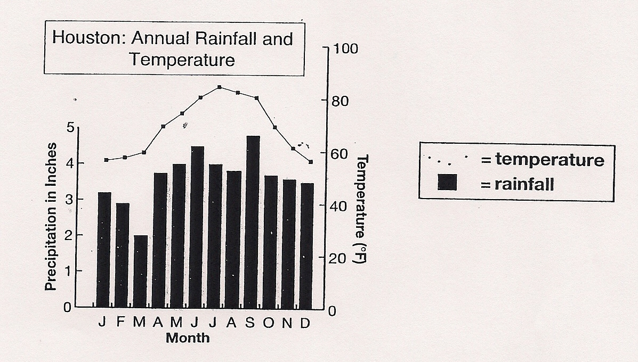
Bell Ringer #2a Geographic Distributions
Which statement about Houston’s climate is correct?
It has more rain in winter than in summer.
July is the wettest month.
March is the driest month.
September is the hottest month.

Slide 13
Bell Ringer #2b Effects of Spatial Diffusion of a Phenomenon
The introduction of sugar cane transformed the Caribbean region because…
large numbers of African slaves were imported to work on sugar cane plantations.
it radically changed the diet of the native inhabitants.
the native people grew rich from the exportation of sugar cane.
many Europeans migrated to the Caribbean region to work as laborers on the sugar cane plantation.

Slide 14
Day 2- Physical Geography
Essential Questions-
How and why do geographers use tools to study the interactions between the physical and human landscapes of Earth?
How do physical forces cause change in the Earth’s landscape over time? How does this alter the human landscape and force adaptations and modifications to the environment? Can you think of any examples?

Slide 15
Key Ideas
Concepts-
Geographic Tools, Systems, Forces of Change, Physical Environment, Climate, Interdependence, Innovation, Human-Environmental Interaction, Physical and Human processes, Adaption, Modification, Region
Vocabulary-
Geography, Human-Environment interaction, Convection, Plate tectonics
Verbs-
Describe, Explain, Compare, Analyze, Identify, Evaluate

Slide 16
Locations: Global- Equator, Prime Meridian, 2 Tropics, 7 continents, 5 oceans North America- Land: The Rockies, Appalachians, Cascades, Canadian Shield Water: Mississippi R., St. Lawrence R., 5 Great Lakes South America- Land: Andes Mts., Isthmus of Panama, Panama Canal, Amazon Rainforest/Basin Water: Amazon R., Caribbean Sea, Gulf of Mexico Europe- Land: Pyrenees Mts., Alps, Ural Mts., Iberian Peninsula, Scandinavian Peninsula Water: Mediterranean Sea, Rhine R., Strait of Gibraltar Africa- Land: Sahara D., Mt. Kilimanjaro, Great Rift Valley, Congo Rainforest/Basin Water: Lake Victoria, Nile R., Congo R. Asia- Land: Himalayas, Gobi D., Indus River Valley Water: Yellow R., Yangtze R., Ganges R., Indus R. Australia, Oceania, Antarctica- Land: Australian Outback Water: Weddell Sea, Great Barrier Reef

Slide 17
Factors that Affect Climate
Latitude (most important)
Air Masses
Continentality
Elevation
Mountain Barriers
Ocean Currents
Pressure & Wind
Storm Tracks

Slide 18
Weather vs. Climate
List what you know about each climate region in the chart on the back of your map.
Notes:
Teacher Script:
Students will take out prepared maps and student resource packet.
Have students complete what they know about each climate region on the provided chart.
Lead a discussion about how climate affects how people live. Have students cut out the chart and glue it on the back of their map. (reference map and information below if needed)
Students will fill in what they know about weather phenomena on their chart. Students will use classroom resources to complete the chart if needed. Have students cut out the chart and glue it on the back of their map.
Students will use the symbol they created on the chart to mark where in the world these phenomena occur on the front of their world map.
Have the students cut out the images for the following resources: oil, coal, lumber, diamonds/gemstones, and nuclear power.
Using the textbook, the students will look up the main locations for these resources and glue them in the proper regions.
Discuss how climate influences the distribution of biomes in different regions.
Review Released Test Question #1, 6, 7, 17
Exit Slip: How does the location of resources determine the development level of a nation?

Slide 19
How does climate affect how people live?
Simple summary of climatic zones:
Polar - very cold and dry all year Temperate - cold winters and mild summers Arid - dry, hot all year Tropical - hot and wet all year Mediterranean - mild winters, dry hot summers Mountains (tundra) very cold all year
The classification is based on maximum and minimum temperatures and the temperature range as well as the total and seasonal distribution of precipitation.

Slide 20
Weather
1. Complete your chart using your knowledge and classroom resources.
2. Using the symbols you created, draw the symbols on the front of your own map in the appropriate places for each phenomena.
.
Stop

Slide 21
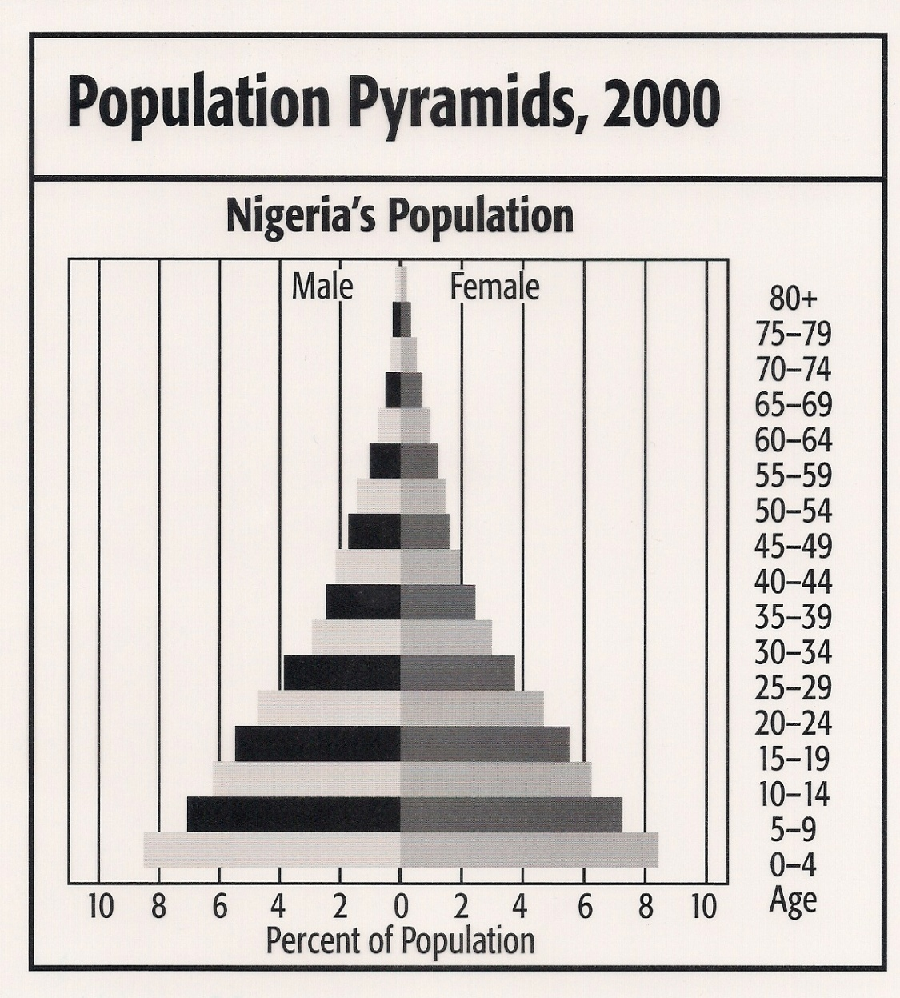
Bell Ringer #3a Critical Thinking Skills
According to the graph, about what percent of Nigeria’s population are males between the ages of 5 and 9?
7%
8.5%
15%
17%

Slide 22
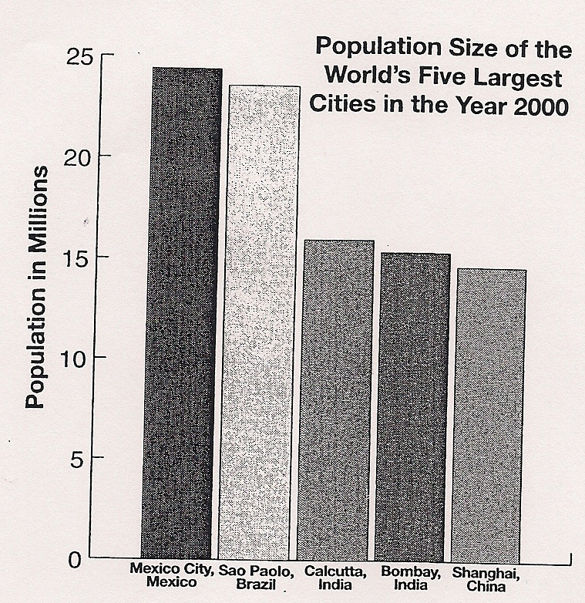
Bell Ringer #3b Size and Distribution of Cities
What conclusion can you draw from the graph of city populations?
Cities are growing too fast for their governments to provide them with adequate services.
One quarter of the world’s population lives in urban areas.
The populations of Latin American cities will soon equal those of Asian cities.
Population in Latin American cities are growing larger than Asian cities.

Slide 23
Day 3- Human Geography
Essential Questions-
How do social, political, and economic factors determine population trends and demographics in a region?
How do physical and human characteristics define places and regions and how and why do they often change over time?
Why do humans modify and adapt to the physical environment?

Slide 24
Key Ideas
Concepts-
- Population, Demographics, Migration, Places, Regions, Character of a place, Human-Environmental Interaction, Impact
Vocabulary-
Region, Push/Pull Factors, Human Geography, Globalization
Verbs-
Describe, Explain, Analyze, Identify

Slide 25
Areas by Size
Universe
Solar System
Planet
Hemisphere
Continent
Region
Country/Nation
State/Territory
County
City
Area

Slide 26
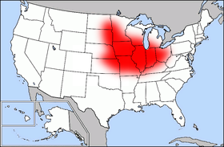
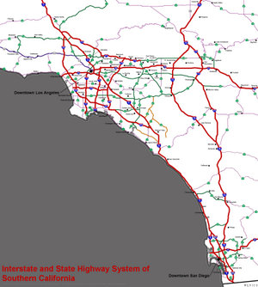
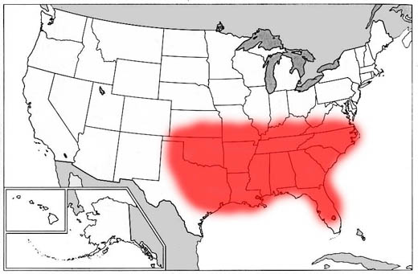
Using the pictures describe the difference between formal, functional, and perceptual regions. Write answer on back in Human Geography section.
Regions
Formal- Ex. Corn belt
Functional- Ex. LA Freeway
system
Perceptual- Bible Belt

Slide 27
Human Environment Interaction
In the section titled “Human Geography,” write a definition for Adapting and Modifying the Environment.
Give two examples for each

Slide 28
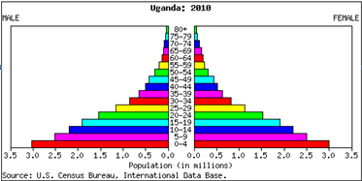
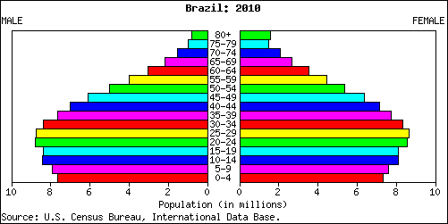
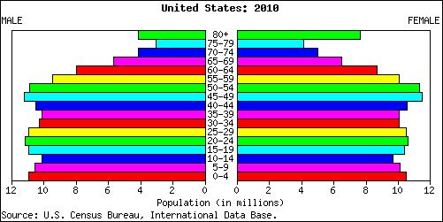
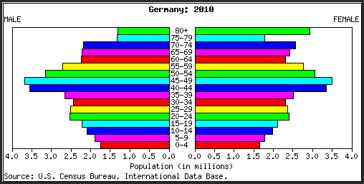
Population
What do population pyramids tell us?
Notes:
Teacher Script
Students will take out prepared maps and student resource packet.
Review population pyramids with students. What inferences can they make about the countries based on the population pyramids in front of them?
Have students cut out population pyramids and glue them on or near the appropriate country. Glue world population pyramid in a corner of the map. Discuss that this population pyramid is from 2010 and how population has since grown to over 7 billion.
Lead a discussion on what countries have very high populations. Have students cut out the two blocks of people ( ) and place them in two of those highly populated countries (i.e., China and India)
Lead a discussion on what countries may have smaller populations but are fast growing. Have students cut out the ‘growth’ images ( ) and glue them on or near two fast growing countries (i.e., Zimbabwe and Uganda)
Review Released Test Question #9
Exit slip: How can we address problems facing fast growing populations? What are challenges facing fast growing populations? What are challenges facing shrinking populations?

Slide 29
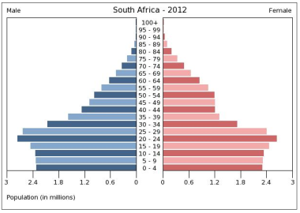
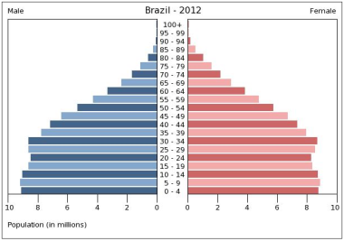
Population Pyramids
1. Draw a line from the population pyramids to the appropriate country. You will have 6 of them.
2. Cut out the blocks of people and glue them in or near two highly populated countries.
3. Cut out the growth images and glue them on or near two fast growing countries.

Slide 30
TOP TEN COUNTRIES WITH THE HIGHEST POPULATION
# | Country | 2000 Population | 2010 Population | 2012 Population | 2050 Expected Pop.
1 | China | 1,268,853,362 | 1,330,141,295 | 1,343,239,923 | 1,303,723,332
2 | India | 1,004,124,224 | 1,173,108,018 | 1,205,073,612 | 1,656,553,632
3 | United States | 282,338,631 | 310,232,863 | 313,847,465 | 439,010,253
4 | Indonesia | 213,829,469 | 242,968,342 | 248,645,008 | 313,020,847
5 | Brazil | 176,319,621 | 201,103,330 | 193,946,886 | 260,692,493
6 | Pakistan | 146,404,914 | 184,404,791 | 190,291,129 | 276,428,758
7 | Bangladesh | 130,406,594 | 156,118,464 | 161,083,804 | 233,587,279
8 | Nigeria | 123,178,818 | 152,217,341 | 170,123,740 | 264,262,405
9 | Russia | 146,709,971 | 139,390,205 | 142,517,670 | 109,187,353
10 | Japan | 126,729,223 | 126,804,433 | 127,368,088 | 93,673,826
TOP TEN Countries |  | 3,618,894,827 | 4,016,489,082 | 4,096,137,325 | 4,950,140,178
Rest of the World |  | 2,466,012,769 | 2,829,120,878 | 2,921,709,597 | 4,306,202,522
TOTAL World Population |  | 6,084,907,596 | 6,845,609,960 | 7,017,846,922 | 9,256,342,700

Slide 31
Population Pyramids
How can we address problems facing fast growing populations?
What are the challenges facing shrinking populations?

Slide 32
Your map should be starting to look like this one….

Slide 33
Exit slip
Choose two population graphs to analyze
Answer the following questions-
Do they show positive, neutral, or negative growth?
Where are the population bulges?
What issues will they have to deal with in the future?
Stop

Slide 34
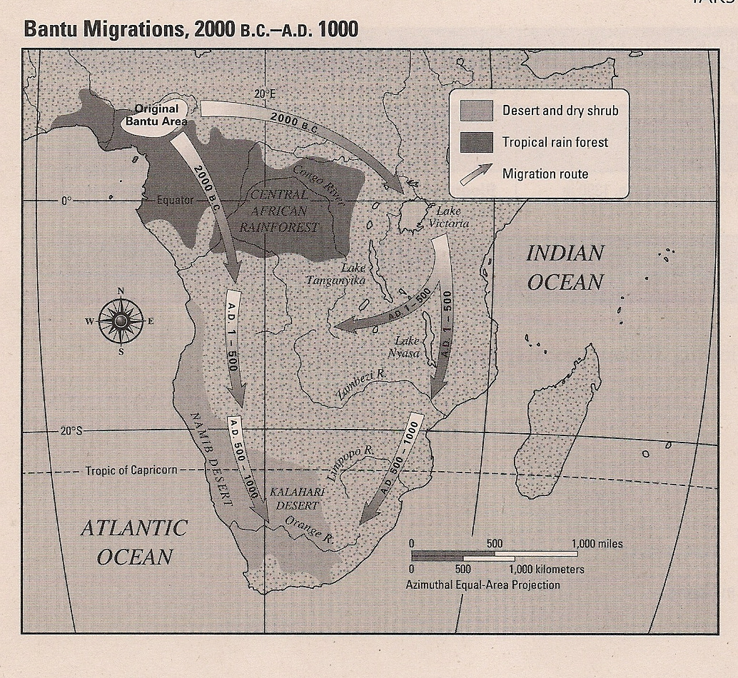
Bell Ringer #4a A Spatial Exchanges and their Influences on the Present
What geographic feature prevented the Bantu from heading north?
Central African Rainforest
Lake Victoria
Namib Desert
Sahara

Slide 35
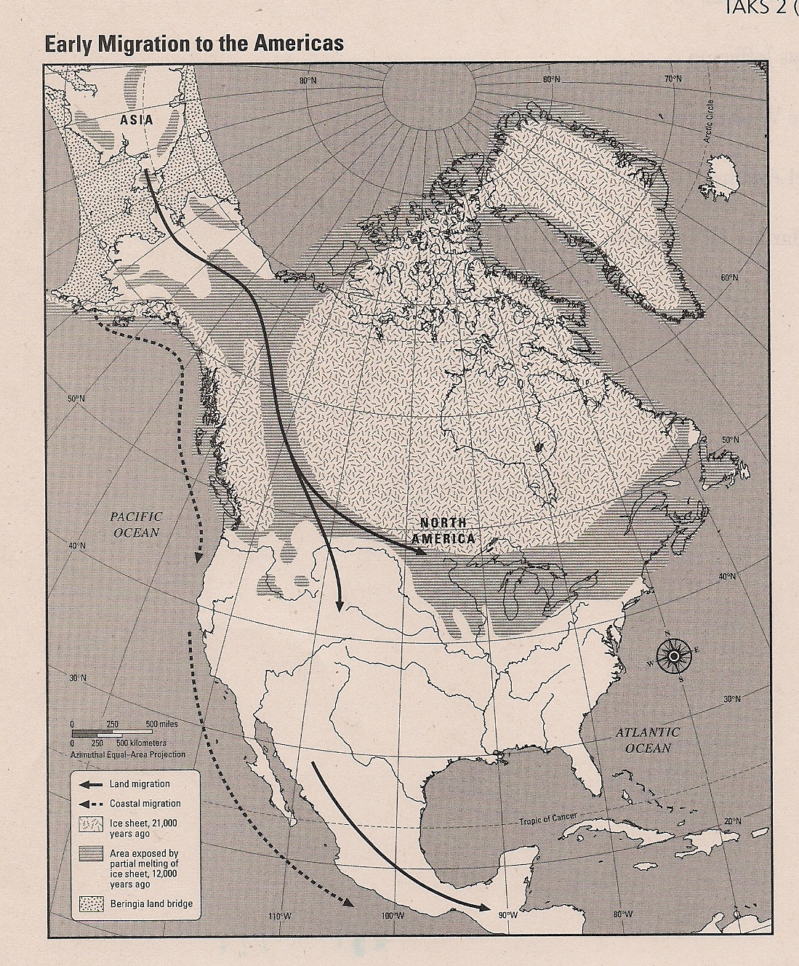
Bell Ringer #4b Spatial Exchanges and their Influences on the Present
According to the map, what geographic feature was essential for migrations to the Americas?
The ice sheet.
The Pacific Ocean.
The Beringia land bridge.
The isthmus of Panama.

Slide 36
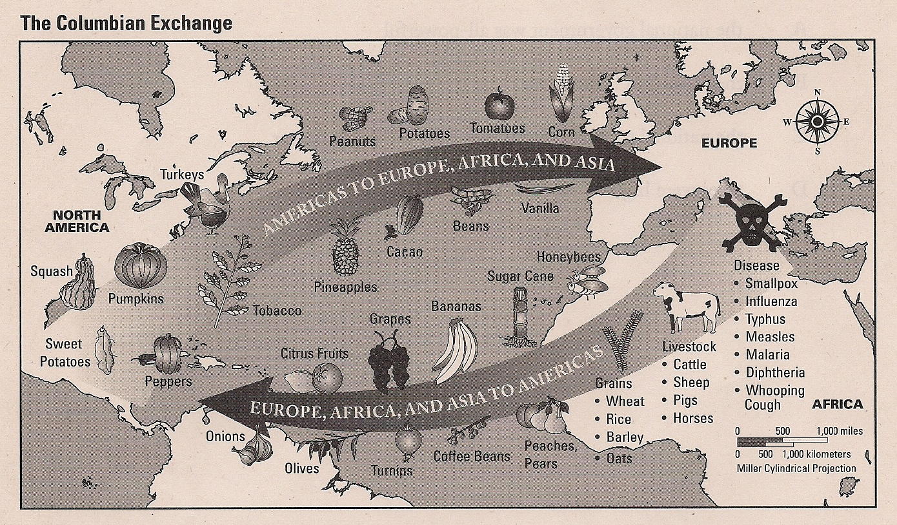
Bell Ringer #4c Effects of Spatial Diffusion of a Phenomenon
Based on the map, which of the following statements correctly describes some of the consequences of the Columbian Exchange?
It spread tomatoes and peppers to the Old World but disease to the Americas.
It resulted in the distribution of pigs and other livestock to Europe and Africa.
It brought pineapples, cacao, and coffee to Africa.
It brought rice to the Americas but spread disease to Asia.

Slide 37
Migration - complete the push/pull chart below in your resource packet.
Notes:
Teacher Script:
Students will take out prepared maps and student resource packet.
Students will complete the push/pull chart on the migration page of their resource packet. Have students glue the chart on the back of their map.
Put the migration map on the projector. Students will draw arrows on their map to show migration routes. Lead discussion with students about the different reasons for each migration.
Show the net migration map (second map below). Discuss the reasons why different regions fall into different categories.
Review Released Test Question #8, 10
Closure: Migration quiz available in student resource packet.

Slide 38
Using the migration map below – draw arrows on your map to show the migration routes.
Latin America
Why did each of these migrations occur?

Slide 39
Net migrations – Why do these different regions fall into these different categories?

Slide 40
Jeopardy-
Geography
Stop

