Slide 1
Middle East Religions
Judaism Christianity Islam

Slide 2
Judaism
Based on the Torah (the Jewish holy book)
Began 3,000 years ago

Slide 4
Judaism
God Revealed himself to Abraham
Monotheism-Belief in only one god
At this time most people around the world were polytheistic (belief in many gods)

Slide 5
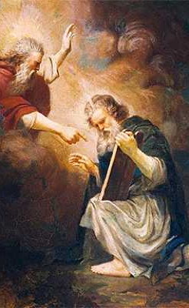
Judaism
Moses receives the 10 commandments
I am the LORD thy God
Thou shalt have no other gods
No graven images or likenesses
Not take the LORD's name in vain
Remember the sabbath day
Honour thy father and thy mother
Thou shalt not kill
Thou shalt not commit adultery
Thou shalt not steal
Thou shalt not bear false witness
Thou shalt not covet

Slide 6
Christianity
Established by the followers of Jesus Christ
Began 2000 years ago
Based on the belief in monotheism
The same god of Abraham that the Jews believed in

Slide 7
Christianity
Roman Catholic
Eastern Orthodox
Pope is the head of the church
Practiced in Western Europe
Roman Emperor was the head of church
Practiced in Eastern Europe

Slide 8
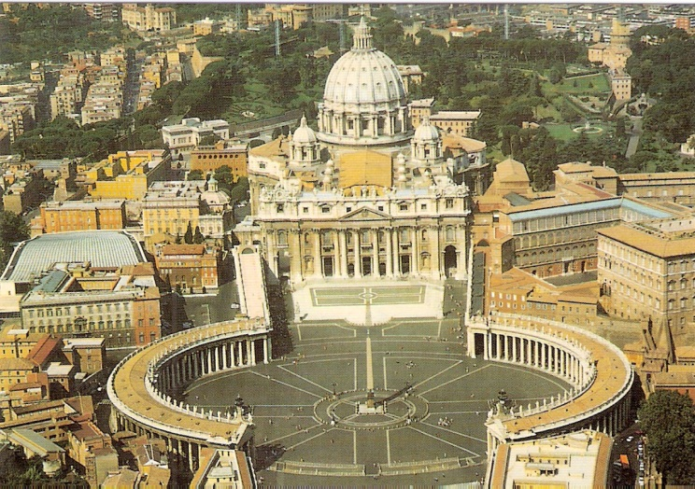
Roman Catholic
St. Peter’s Basilica
Vatican City Independent Country -Microstate
Located inside Rome, Italy

Slide 9
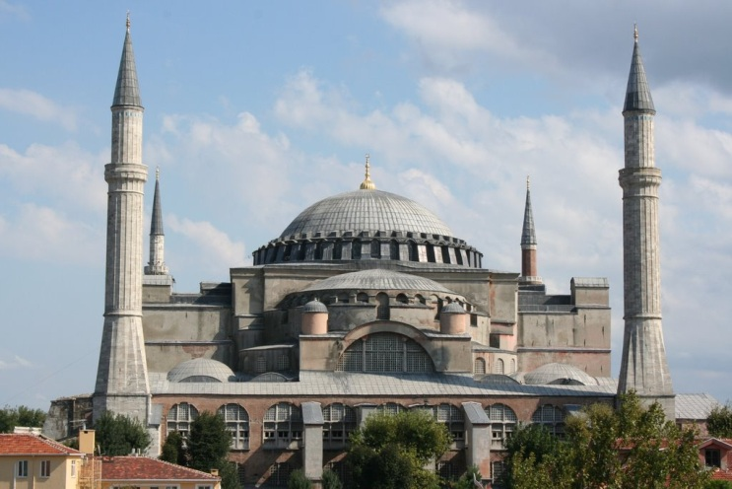
Eastern Orthodox
Haga Sophia
Istanbul- Constantinople Turkey

Slide 11
Christian Religions
Baptist
Lutherans
Calvinist
Anglican Church
Methodist
Church of Christ
Anabaptist
Bretheren

Slide 12
Islam
Based on the teachings of Mohammed
Prophet of Allah

Slide 13
Islam
Five Pillars of Islam
Arabic Creed –
Pray 5 times a day
Give Alms to the poor
Pilgrimage to Mecca
Observe Ramadan

Slide 14
Islam
Arabic Creed
There is no god but Allah, Muhammad is the messenger of God.

Slide 15
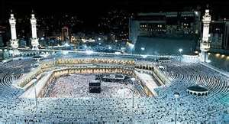
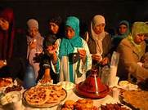
Islam
Hajj
Ramadan

Slide 16
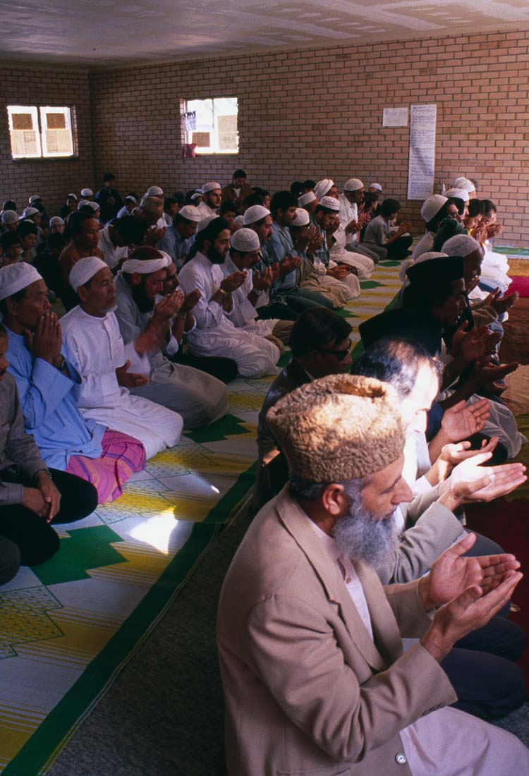
Islam
Alms for the poor
Pray 5 times a day

Slide 17
Islam
Mainly practiced in North Africa, Southwest Asia and Southeast Asia
Fastest growing religion in the world

Slide 18
Islam
Growth thru trade
Jihad
A war against non muslims

