Slide 1
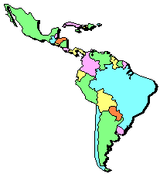
The Geography
of
Latin America

Slide 2
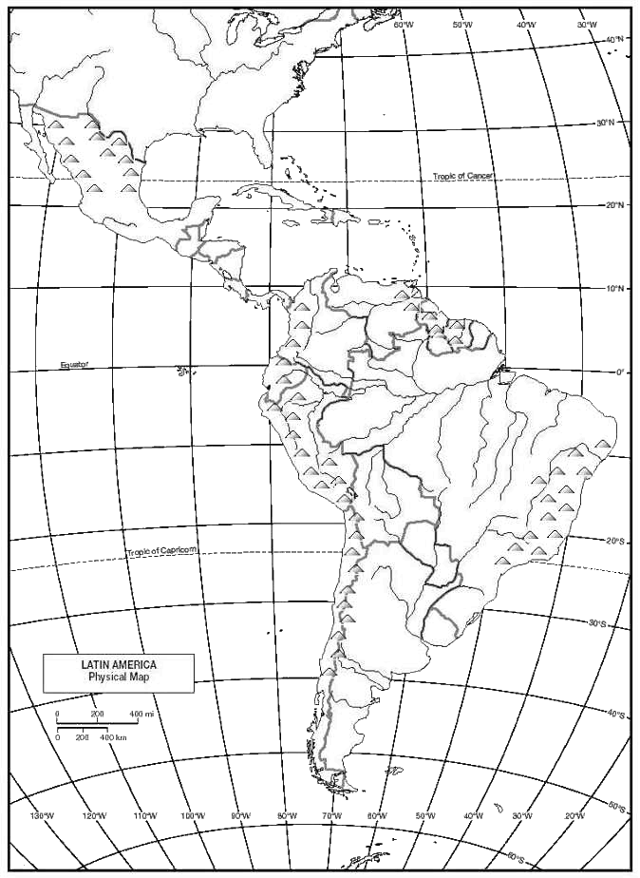
Regions of Latin America
The Caribbean
Central America
South America

Slide 3
Topography

Slide 4
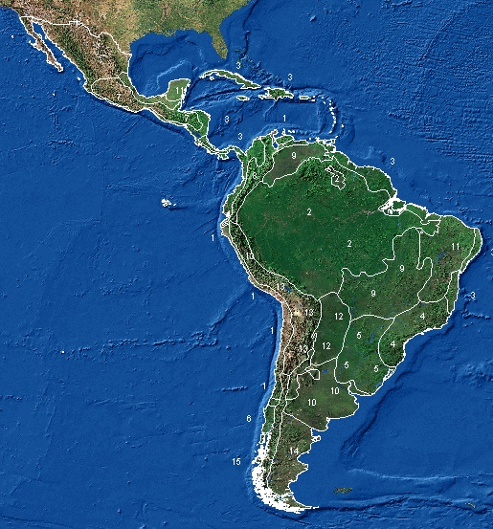
Satellite Image of Latin America

Slide 5
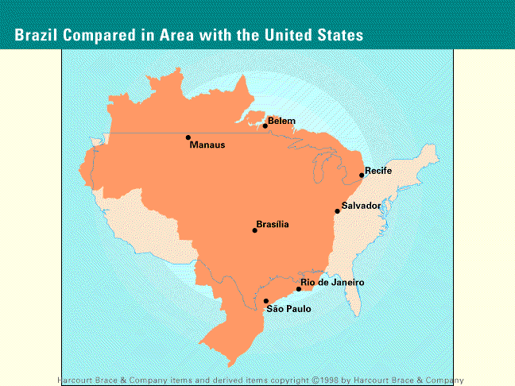

Slide 6
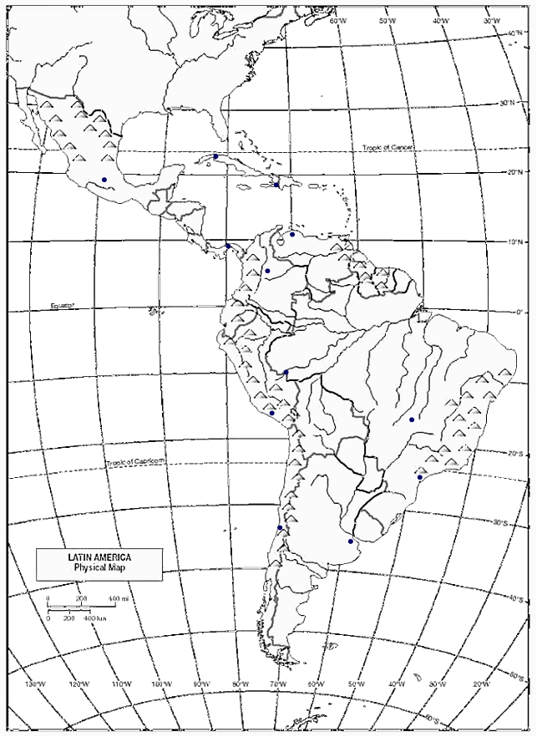
Bodies of Water
Gulf of Mexico
Caribbean Sea
Lake Maracaibo
Orinoco R.
Magdalena R.
Amazon R.
Pacific Ocean
Sao Francisco R.
Lake Titicaca
Parana R.
Uruguay R.
Rio de La Plata
Atlantic Ocean

Slide 7
Mountains and Peaks
Sierra Madres Mts.
Guiana Highlands
Andes Mts.
Brazilian Highlands
Patagonian Plateau

Slide 8
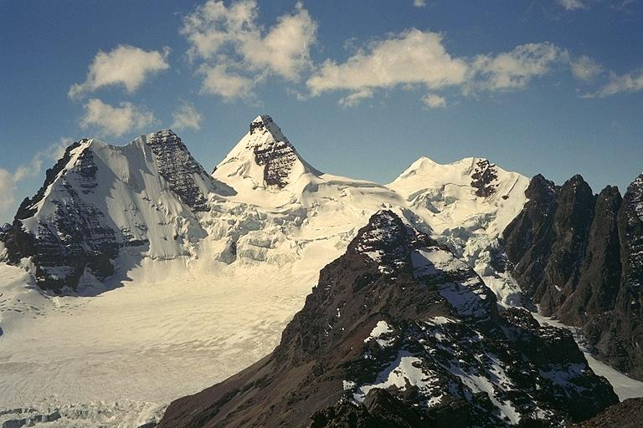
Andes Mountains (Peru)

Slide 9
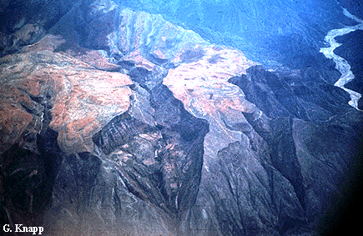
The Eastern Flank of the Andes

Slide 10
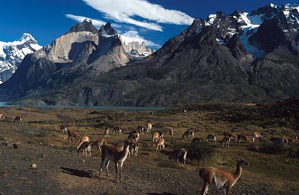
Llamas in the Andes

Slide 11
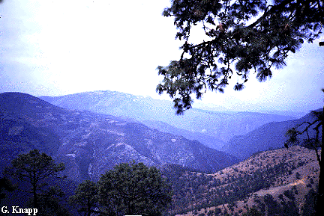
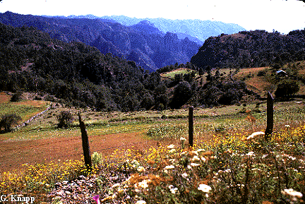
The Sierra Madres, Mexico

Slide 12
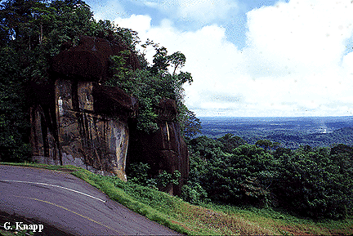
Guianan Highlands, Venezuela

Slide 13
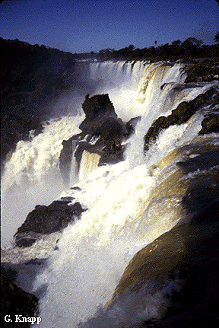
Brazilian Highlands

Slide 14
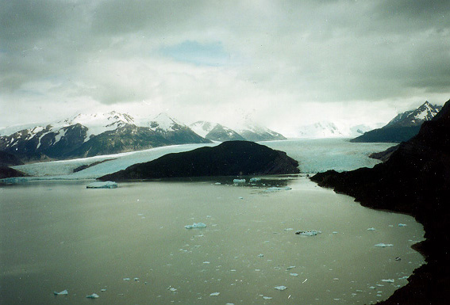
Patagonian Region (Chile)

Slide 15
Valleys Plains and Basins
Llanos
Amazon Basin
Mato Grosso
Gran Chaco
Pampas

Slide 16
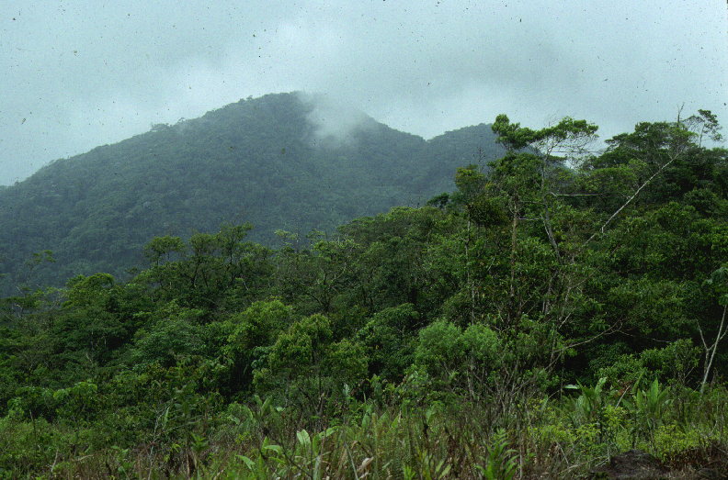
Amazon Rain Forest

Slide 17
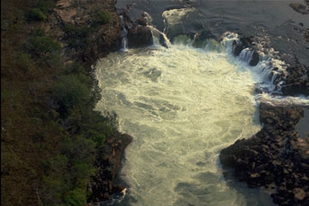
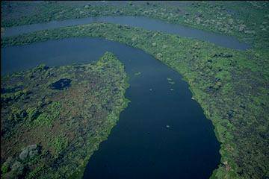
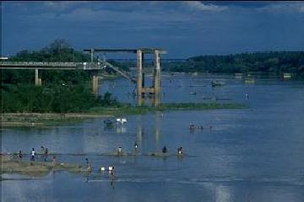
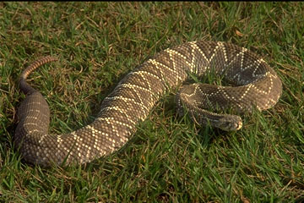
Mato Grosso

Slide 18
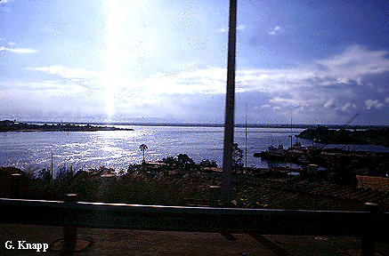
Orinoco Lowlands, the Llanos

Slide 19
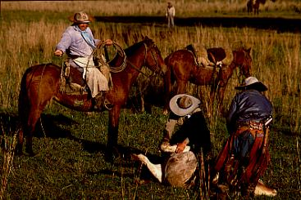
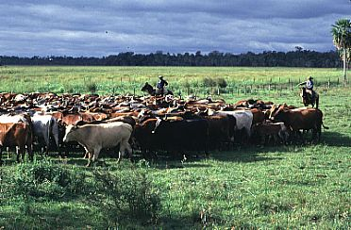
Cattle Ranching on the Pampas

Slide 20
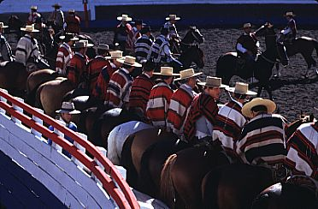
Gauchos of the Pampas, Argentina

