Slide 1
The Factors that Affect Climate: LACEMOPS
Much of the information in this Power Point came from Linda Hammon.

Slide 2
Important Vocabulary
Weather – The daily condition of the atmosphere which includes temperature and precipitation.
Precipitation – Moisture that falls from the sky. Precipitation has 4 forms: rain, snow, sleet, and hail.
Climate – Weather conditions over time. Most scientists say you need at least 30 years of weather records to be able to make a decision about climate type.

Slide 3
Climograph
A graph that indicates average temperature and precipitation for an area.
These graphs can answer the following types of questions:
How much rain is there in a particular location?
When is it dry?
Is it wet when it’s cool?
What vegetation can grow there?

Slide 4
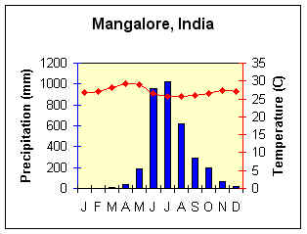
How to Read a Climograph
Look at the title to see what location’s climate is being described by the graph.
The numbers on the left show you the amount of precipitation. Make sure you check to see if the precipitation is measured in millimeters or inches.
The numbers on the right show you the temperature. Make sure you check to see if the temperature is measured in degrees Fahrenheit of Celsius.
The letters at the bottom show you the months of the year.

Slide 5
How to Read a Climograph
The bar graph measures the average precipitation for each month. The numbers that measure it are on the left side of the graph.
The line graph shows you the average temperature for each month. The numbers that measure it are on the right side of the graph.

Slide 6
Using the acronym LACEMOPS to help you understand CLIMATE .
L-latitude
A-air masses
C-continentality
E-elevation
M-mountain barriers
O-ocean currents
P-pressure (air) and prevailing winds
S-storms

Slide 7
L is for Latitude

Slide 8
Latitude
This is the most important factor determining climate.
The farther you are from the Equator – the colder and drier it becomes.
The only place on the planet we get rays beating down directly overhead from the sun is in the tropics. Areas not in the tropics receive indirect sun rays.

Slide 9
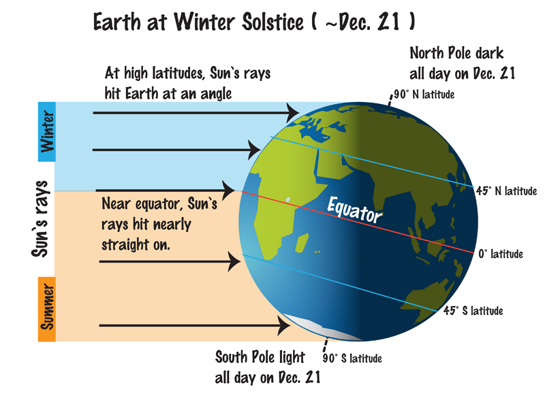

Slide 10
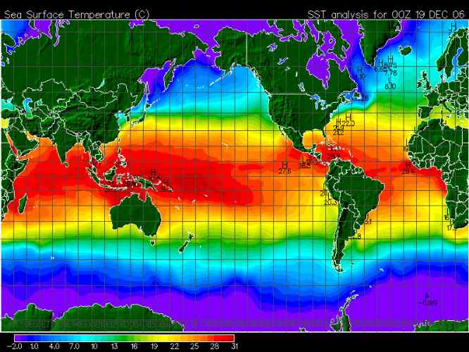
Zones of Latitude
HIGH
High: Polar climates.
Middle: Temperate Climates
Low: Tropical Climates
MIDDLE
LOW
MIDDLE
HIGH

Slide 11
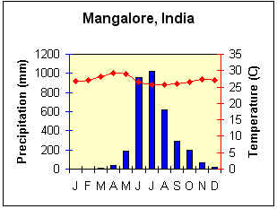
One factor that effects the temperature of a place
is the amount of sunlight it receives.
Notice how the temperature line on the climograph is almost level? This location is near the equator. It receives the same amount of sunlight all year which results an almost straight temperature line.
Tropical Wet and Dry Location

Slide 12
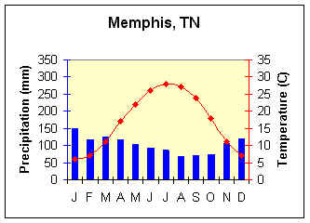
The second location is further from the equator. The curved temperature line shows that the amount of sunlight this location receives varies with the seasons.
Humid Subtropical Location

Slide 13
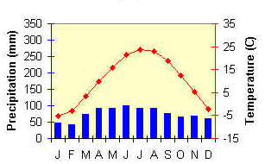
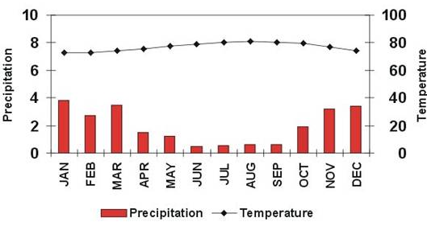
Study the two climographs below.
Can you pick out the one that depicts a tropical climate? How do you know?
Bonus Question: Is it a tropical wet or a tropical wet and dry climate? How do you know?
Climate A
Climate B

Slide 14
A is for Air Masses

Slide 15
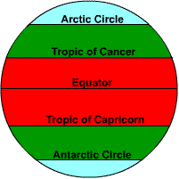
Air Masses
In the northern hemisphere, cold air from the polar regions comes from the north and hot air from the tropics comes from the south.
In the southern hemisphere, cold air from the polar region comes from the south and hot air from the tropics comes from the north.

Slide 16
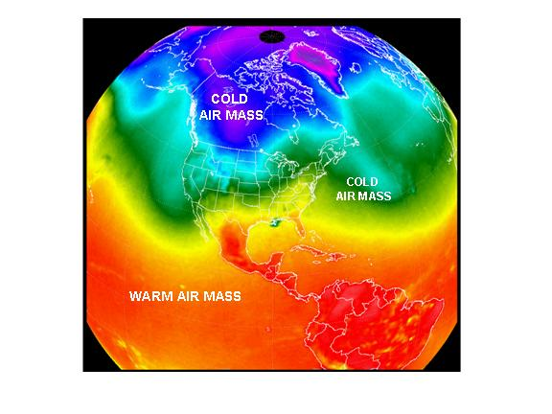
An air mass is a large (usually thousands of miles across) volume of air where the temperature is the same across horizontal bands. To a lesser extent the amount of humidity is similar across these bands too.

Slide 17
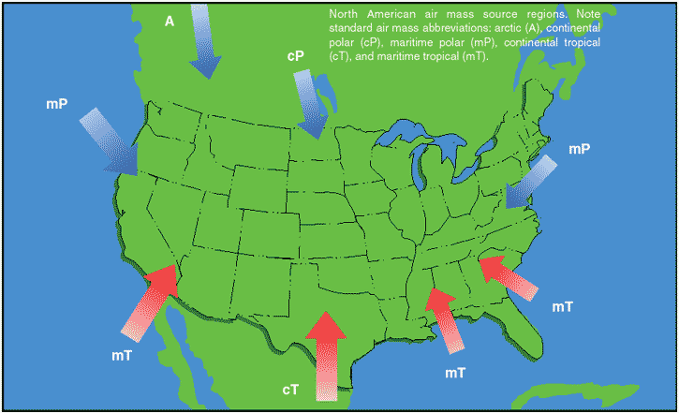
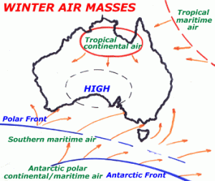
Why is the direction that cold air comes from flip flopped in the Northern and Southern Hemispheres?

Slide 18
C is for Continentality

Slide 19
Continentality
Water moderates climate. To moderate means to make milder: not as hot or cold.
Water takes longer to heat and cool than land. So locations near water don’t heat up or cool down quickly. Consequently, the temperature doesn’t vary as much during the year. No hot, hot summers or cold, cold winters.
Since land DOES heat up and cool quickly, areas inland from the coast will be hotter in the summer and colder in the winter than areas with the same latitude on the coast.

Slide 20
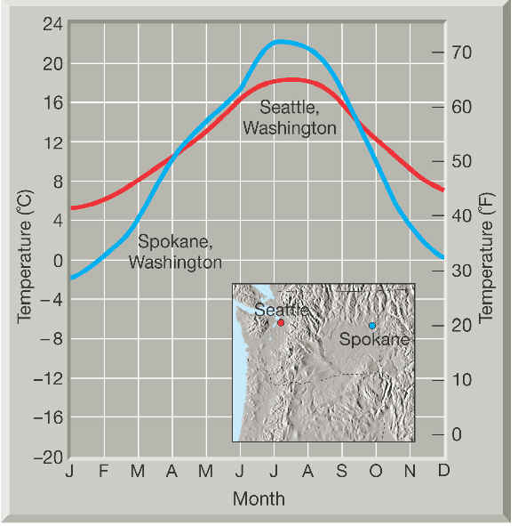
If there is a big difference between the temperature in the winter and the temperature in the summer, a climate is most likely far from the sea. Scientists often look at the difference between the average temperatures prevailing in January and July as an indicator of this.
Notice the bigger difference in temperature between January and July in Spokane? It is further inland
than Seattle on the map.

Slide 21
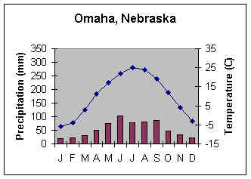
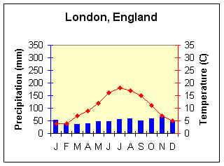
Continentality: How Does It Affect Climate?
Remember: continentality is the effect of location on a continent on the climate of a place. Inland locations typically have larger temperature ranges and (possibly) drier conditions than maritime locations.
Compare these two locations. Which one is further inland? How can you tell?

Slide 22
E is for Elevation

Slide 23
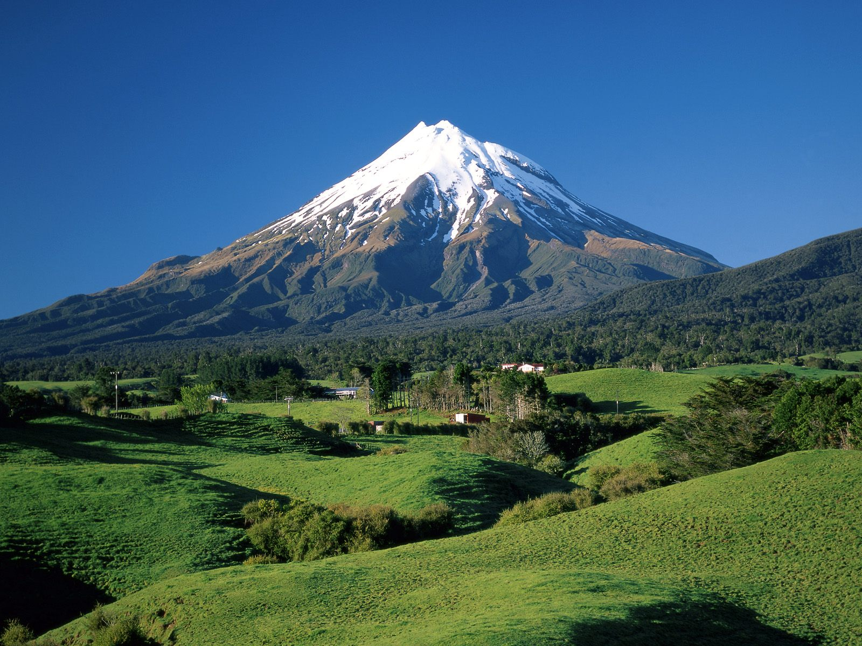
Elevation
It gets colder as you go up a mountain.
The formula for vertical climate: the temperature decreases 3.5°F for every 1,000 ft of elevation.

Slide 24
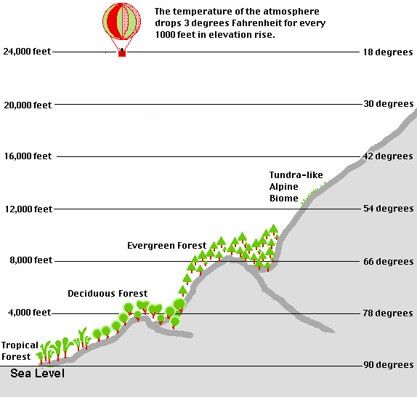
Elevation
Remember: elevation affects climate and climate affects the type of vegetation.

Slide 25
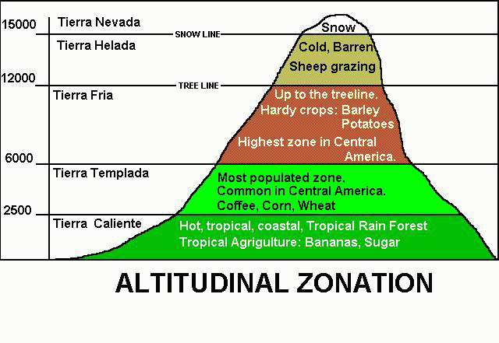
Not only does elevation affect the type of natural vegetation that will grow in a region, it also affects what types of crops humans can grow.

Slide 26
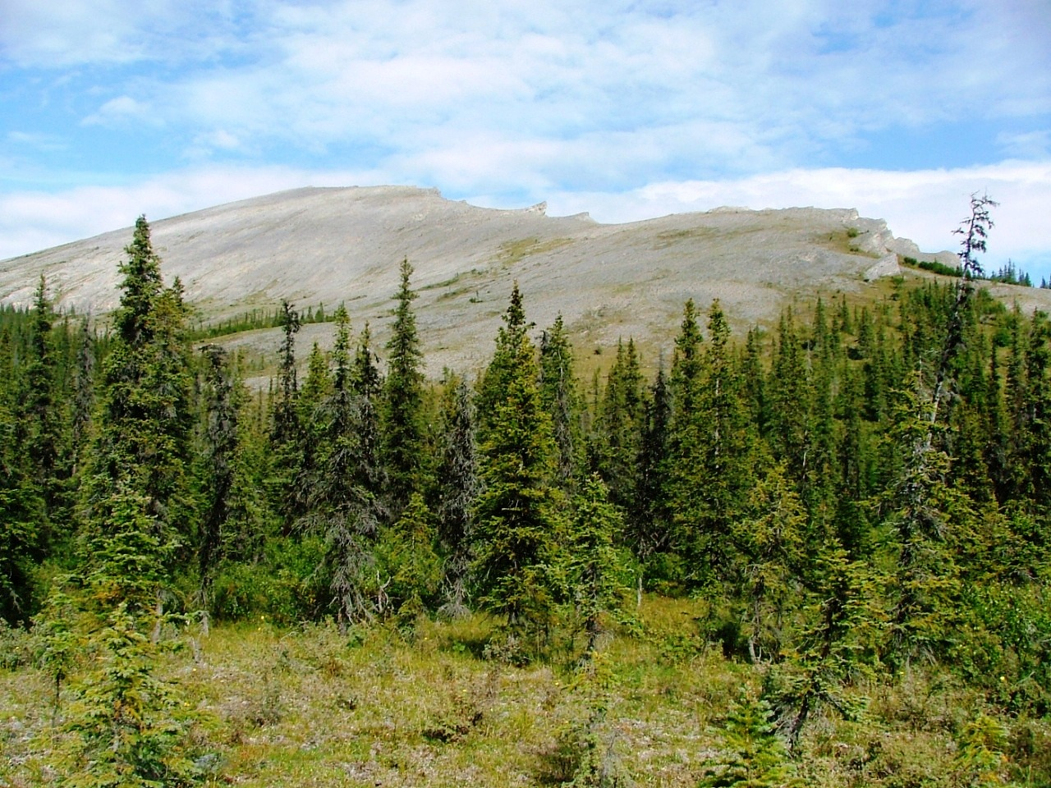
In this photo, you can see the tree line-the highest point on a mountain that trees can survive.

Slide 27
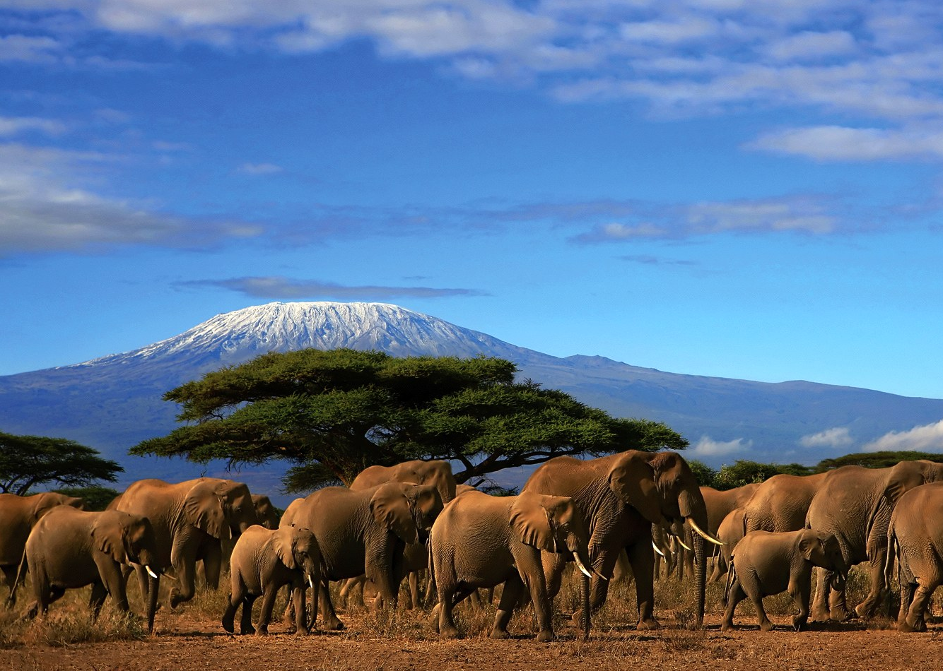
This cooling effect of elevation stems from low atmospheric pressure -- with less air to push down on the mountains, the air molecules spread out and lose energy.

Slide 28
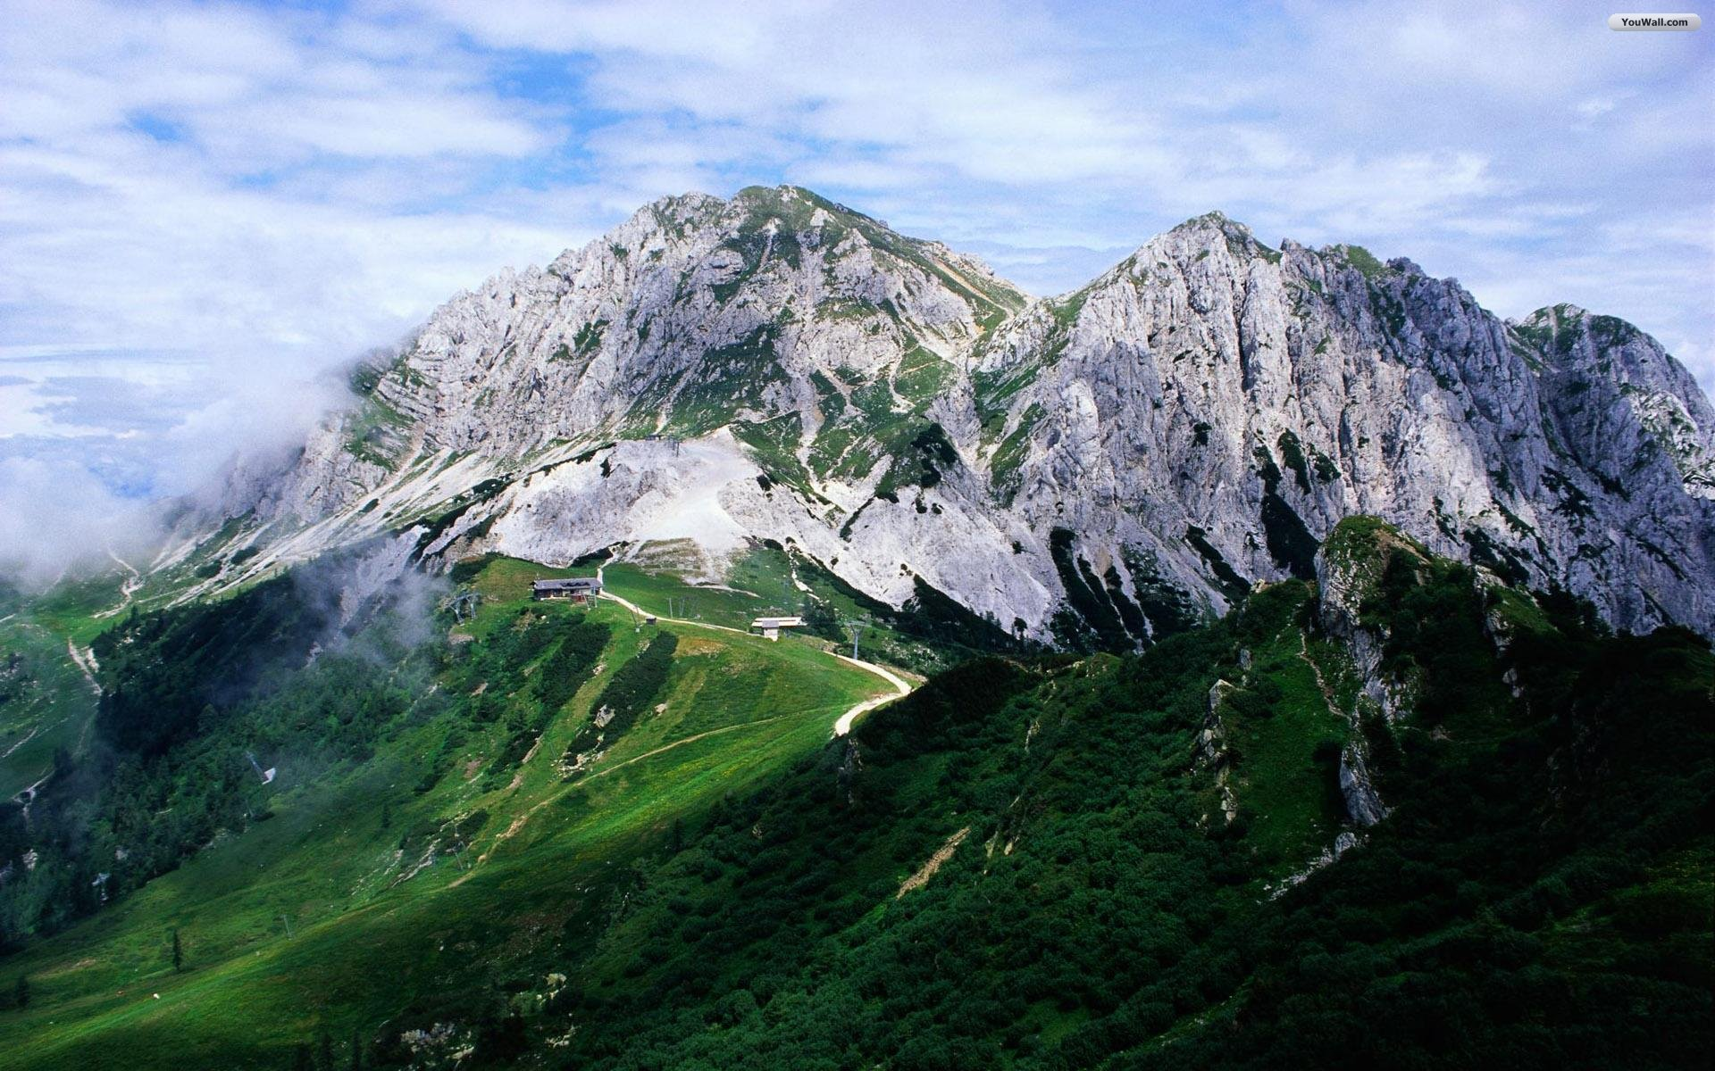
If it is 75° at the base of a 10,000 ft tall mountain, what would the temperature be at the top? Remember: temperature drops 3.5° Fahrenheit every 1,000 feet.

Slide 29
M is for Mountain Barriers

Slide 30
Mountain Barriers
Mountains can stop storms and air masses.
If you look at the physical map of southern Europe below, you will see that there are mountains that block cold north winds from reaching the Iberian, Italian and Balkan Peninsulas.

Slide 31
Mountains are also responsible for
the orographic effect.
Wind containing moisture hits the windward side
of a mountain (the side facing the wind).
The moisture full clouds are too heavy to make it over the mountain so precipitation occurs.

Slide 32
Mountain Barriers (continued)
After the precipitation, the clouds have no moisture and are able to rise over the mountain.
The side facing away from the wind is called the leeward side.
The leeward side of a mountain is arid.
The windward side has lush vegetation.
The leeward side of a mountain is in the rain shadow and is usually a desert.

Slide 33
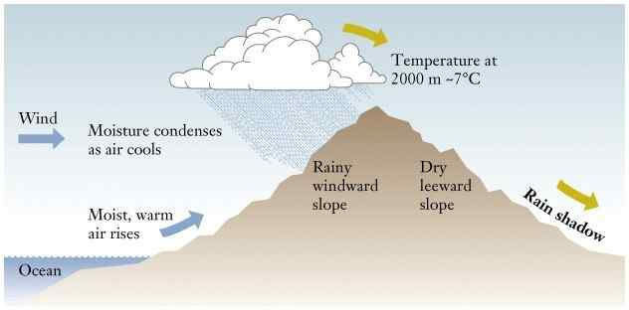
Mountain Barriers: Rain Shadow

Slide 34
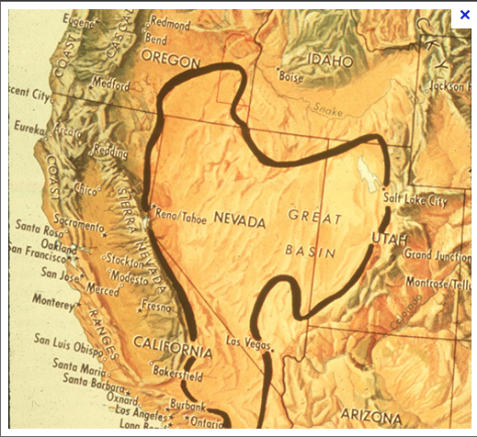
How would you explain the formation of the Great Basin in the American Southwest?

Slide 35
O is for Ocean Currents

Slide 36
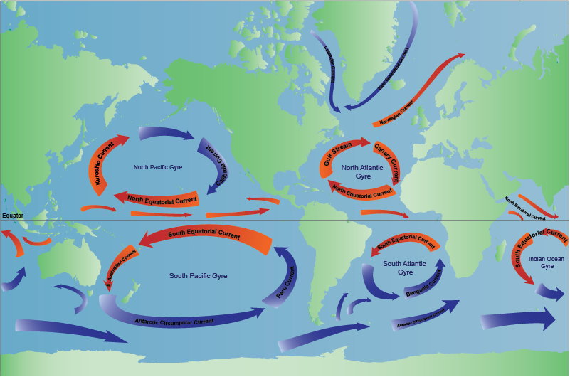
Ocean Currents
Cold currents create dry conditions on the coast.
Warm currents create wet conditions on the coast.

Slide 37
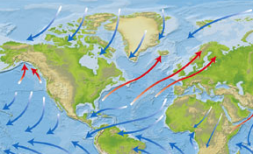
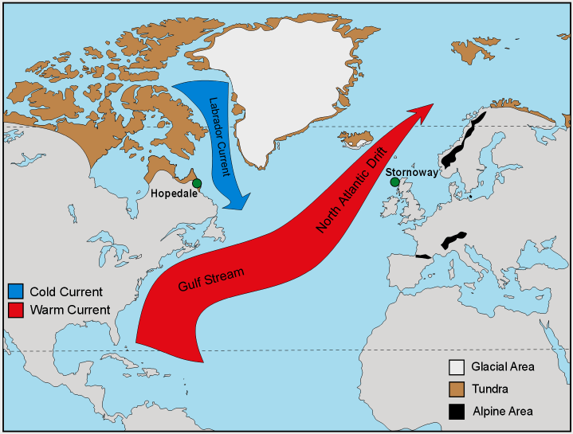
Wind Patterns
Ocean Currents
Study the North Atlantic wind pattern map and the North Atlantic ocean current map. If Western Europe is at roughly the same latitude as Canada, why is the climate of Western Europe so much warmer?

Slide 38
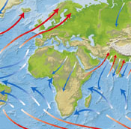
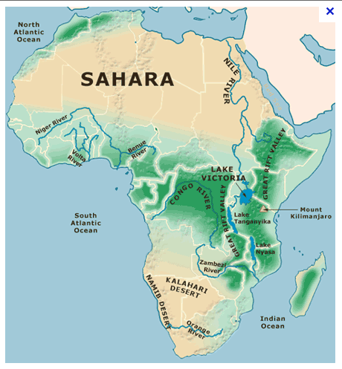
Ocean Currents
Physical Map of Africa
Using both maps above, how do you explain the existence of the desert region of southwestern Africa?

Slide 39
P is for Pressure and Prevailing Winds

Slide 40
Air Pressure
Areas of high pressure occur at 90° N and S and at 30° N and S where you have dry air sinking. High air pressure means generally the area will be dry. At the Equator and at both lines of 60° latitude, the air is rising. Where air rises, you get rain, so those areas tend to be humid.

Slide 41
Pressure
High Pressure =H Heavy, cool air, brings clear skies and no rain.
Low Pressure =L Light, warm air, usually brings precipitation
Pressure systems blow from areas of high pressure to low pressure centers.

Slide 42
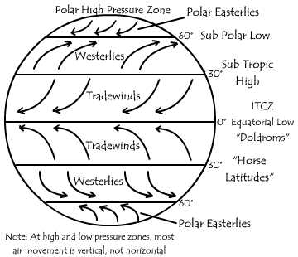
Prevailing Winds
Prevailing winds generally blow from the same direction all the time.
These prevailing winds have names.

Slide 43
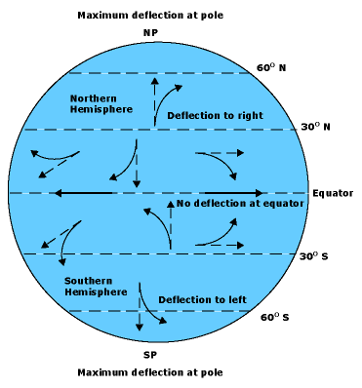
Earth’s winds would blow in straight lines, but since the earth rotates they are turned at an angle. In the northern hemisphere, they turn to the right. In the southern hemisphere they turn to the left. This bending of the wind is called the Coriolis Effect.
Wind and the Coriolis Effect

Slide 44
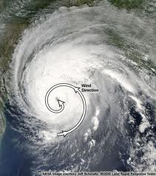
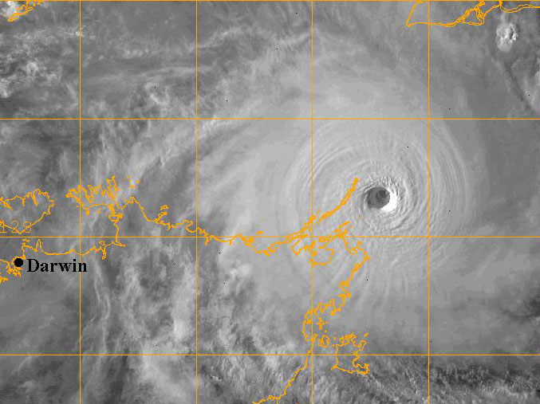
Cyclonic storms (hurricanes, typhoons, etc.) in the Northern Hemisphere spin counter-clockwise. In the Southern Hemisphere cyclones spin clockwise.
Southern Hemisphere
Northern Hemisphere

Slide 45
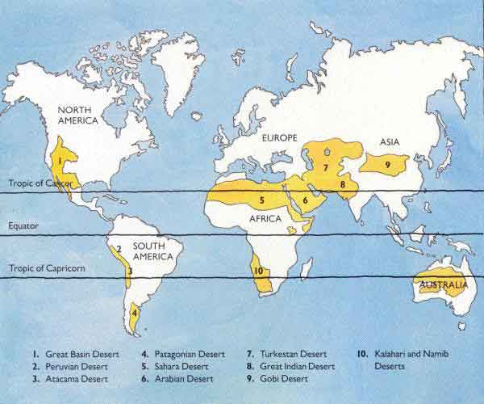
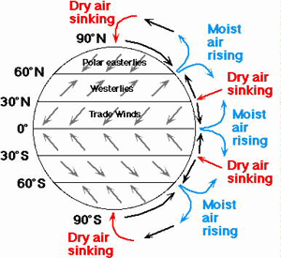
What relationship can you detect between the diagram and the map of the world’s major deserts? HINT: Think high pressure vs. low pressure.

Slide 46
S is for Storms

Slide 47
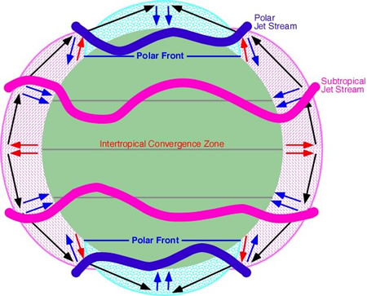
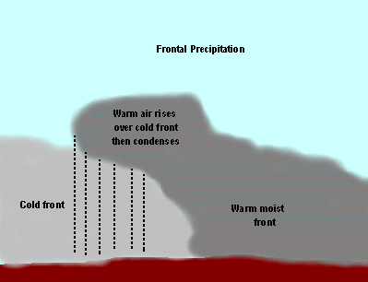
Storms
Where polar winds meet westerlies --there are storms.
When hot air masses and cold air masses collide – there are storms.

Slide 48
Storm Tracks
Cat. 5 Hurricane
Tropical Storm
Tornado
Cyclone

Slide 49
L atitude
A ir Masses
C ontinentality
E levation
M ountain Barriers
O cean Currents
P ressure and Prevailing Winds
S torms
This acronym was .introduced by:
Dr. James Petersen – Texas State University – San Marcos, TX, 1990.

Slide 50
Handy guide to remembering the connections between climate and vegetation:
Trees grow naturally in wet regions.
When rain supply equals demand for rain grasses grow.
Desert plants grow where there is a moisture deficit.

