Slide 1
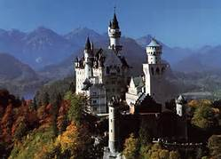
Europe

Slide 2
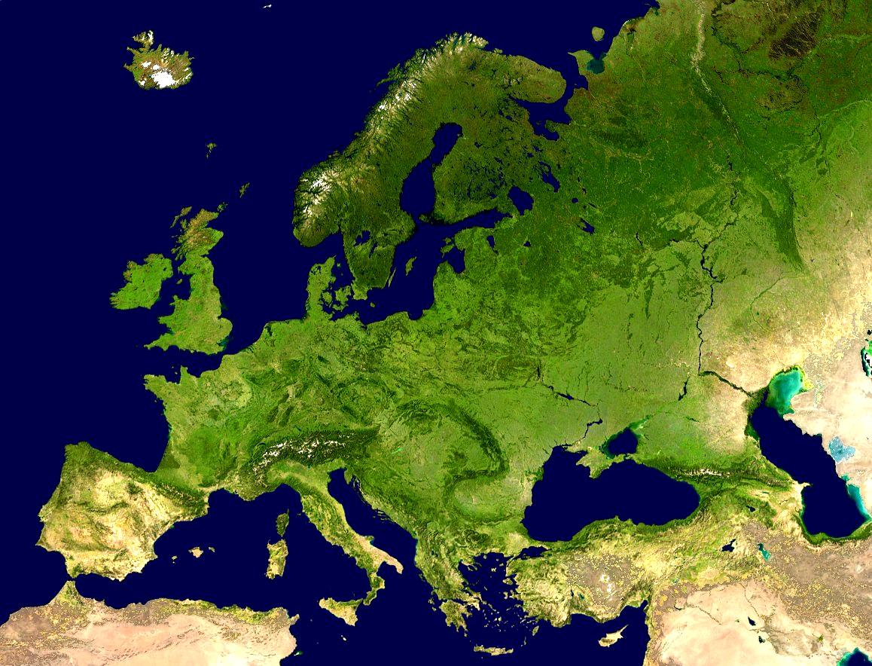
Geography
Western edge of Eurasia
Pervasive world influence
Industrialized
Numerous nation-states
Urbanized population
High standards of living
Developed countries

Slide 3
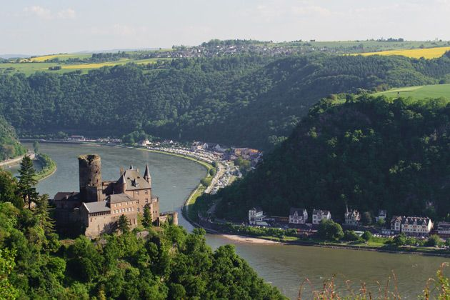
Geography
Centrally located
Every part of Europe is within 300 miles of Seas.
Navigable waterways
Moderate distances
Resources like iron and coal

Slide 4
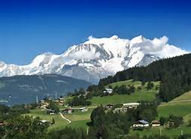
Geography
Alpine Areas
The Alps, Pyrenees
Dolomites, Carpathians
Peninsulas
Scandinavia, Italian
Iberian, Balkan
North European Plain

Slide 5
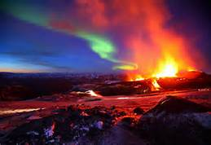
Europe’s Islands
Iceland
an island south of the Arctic circle in the North Atlantic Ocean
Volcanoes, hot springs and geysers

Slide 6
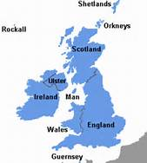
Europe’s Islands
The British Isles
Ireland
Great Britain
Primarily cool, rainy and hilly

Slide 7
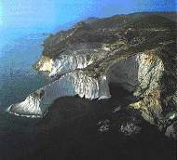
Europe’s Islands
Mediterranean
5 Large Islands
Volcanoes
Sicily, Corsica, Sardinia,
Cyprus, and Crete
Volcanoes
Greece’s 2,000 in the Aegean Sea
Rugged landscapes
Sunny climates

Slide 8
Europe’s Climate
Marine West Coast – dominates Western Europe
Humid Continental – dominates Eastern Europe with pockets of steppe and highland
Mediterranean climate – found along the southern part of Europe along the Mediterranean coastline

Slide 9
Biomes / Land Use
Biomes
Land Use
Most of Europe is Temperate mixed forest
Scandinavia has coniferous forests
Mediterranean has the scrubby vegetation known as chaparral
Typically mixed farming or dairy farming
Mediterranean farming includes wine and olive oil production
Highlands are used for grazing (beef and milk products come out of these areas – swiss cheese)

Slide 10
History of Europe
Ancient Greece & Rome( 8th century BCE – 4th century)
Dark Ages (4th – 10th century)
Middle Ages (10th – 14th century)
Renaissance (15th – 16th century)
Enlightenment (18th century)
Age of Conquests (15th – 20th century)

Slide 11
Agricultural Revolution
Began in Europe in 1750’s
Based on Agricultural innovations
Increased food production
Sustained population increases
Crop rotation
Fertilizers
Seed Drills
Threshing machines

Slide 12
Industrial Revolution
Developed in the UK 1750-1850
Evolved from technical innovations that occurred in British Industry
Increased urbanization as a result

Slide 13
Europe’s Changing Population
Falling share of the world’s population
All-time low fertility rates
Fewer young people
Smaller working age population
Immigration partially offsetting losses

Slide 14
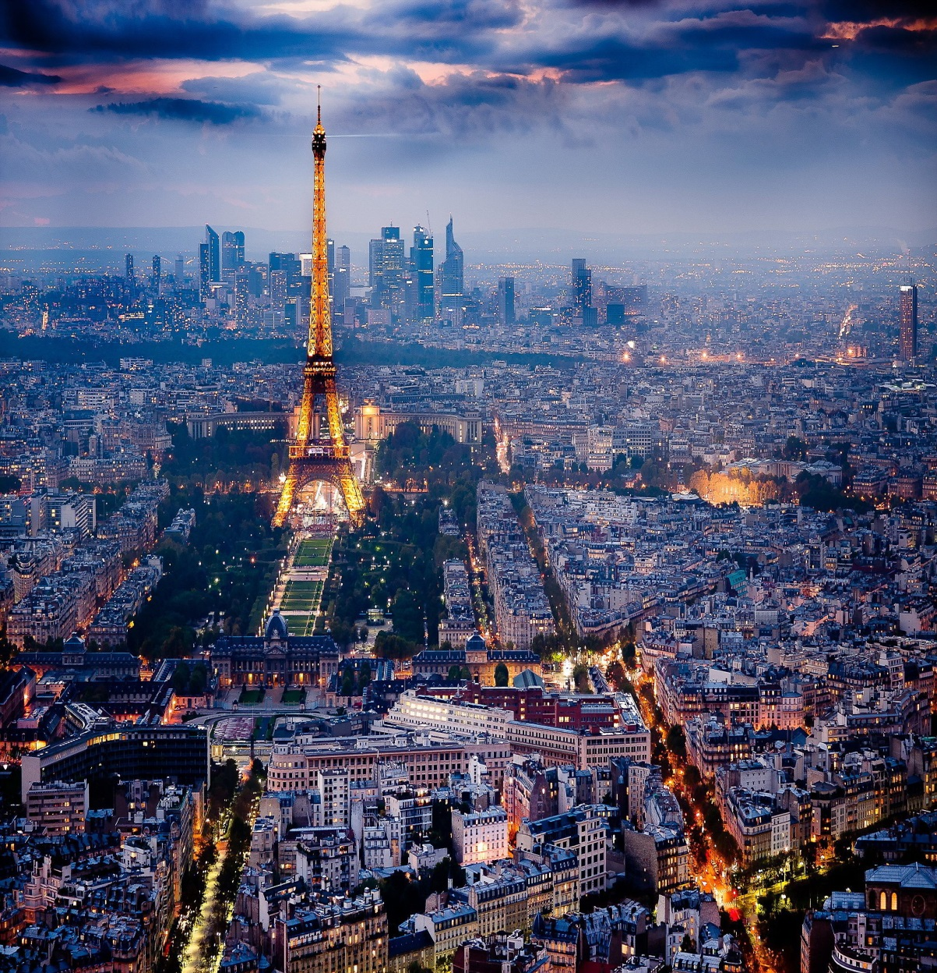
Urban Tradition
Urbanization – 73% of Europe is urbanized
Primate City – largest city that encompasses the cultural ideals
CBD – Downtown
Metropolis- describes the city and suburbs

Slide 15
20th Century
Major Political Events
World War I
World War II and Holocaust
Cold War
Decrease in Imperialism
Rise and Fall of Communism

Slide 16

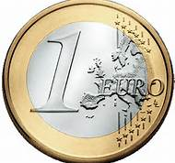
Supranationalism
A venture involving three or more nations
Political, economic, and/or cultural cooperation to promote shared objectives

Slide 17

European Union (EU)
Original Members: (12) Belgium, Denmark, France, Germany, Greece, Ireland, Italy, Luxembourg, Netherlands, Portugal, Spain
Established: 1992
Aimed to coordinate policy among members in three ways:
    Economics
    Defense
    Justice and home affairs

Slide 18
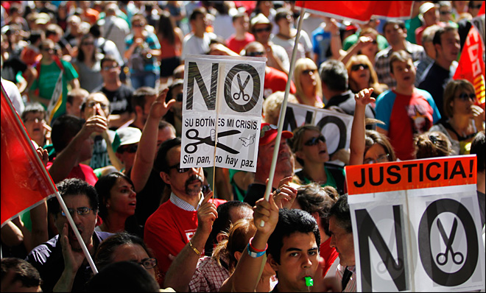
Supranational Problems
Loss of autonomy and control
Differences in levels of economic development
Cultural barriers

Slide 19


Languages
Indo-European language family has over
50 different languages
100 dialects
Slavic Languages – Eastern Europe
Germanic Languages- northern Europe
Romance Languages – Southern Europe

Slide 20
Religions
Predominantly Christian
Most of southern & western Europe’s Christian are Roman Catholics
Most northern Europeans Christians are Protestants.
In much of southeastern Europe, Eastern Orthodox Christians predominate
Many Muslims & Jews also live Europe

Slide 21
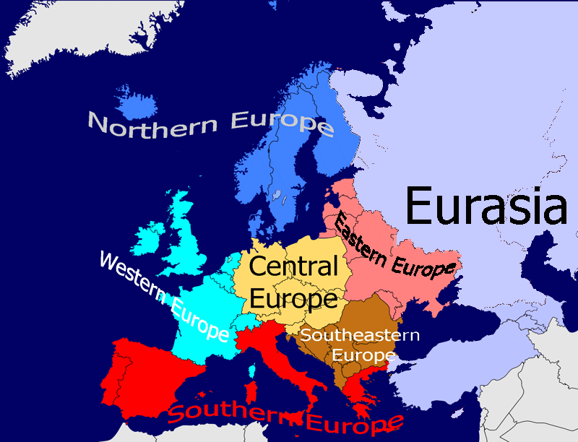
Regions of Europe
Western Europe
Eastern Europe
British Isles
Northern Europe
Mediterranean Europe

