Slide 1
Buddhism
World Religions

Slide 2
Buddhism
Buddhism currently has about 376 million followers
fourth largest religion
founded in Northern India by Siddhartha Gautama (circa 563 to 460 BCE)
spread into much of the far East

Slide 3
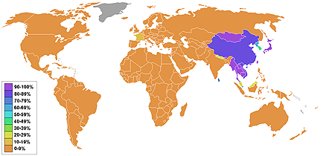
Buddhist World

Slide 4
Buddhism & Hinduism shared beliefs
Karma is the sum total of an individual's actions of body, speech and mind -- good, bad and neutral -- taken in their current and previous lives.

Slide 5
Buddhism & Hinduism shared beliefs
Reincarnation is the rebirth of a living being after death into a new body that is either a human, animal or a supernatural being.

Slide 6
Buddhism & Hinduism shared beliefs
Dharma, in Buddhism, refers to two items:
-The teachings of the Buddha; a person's path to enlightenment, and
-The fundamental principles that order the universe

Slide 7
Forms of Buddhism
Theravada – Southeast Asia
Mahayana – Northern Asia
Vajrayana – Considered part of Mahayana Buddhism
Tibetan – Tibet due to isolation
Zen- Chinese Mahayana
Modern

Slide 8
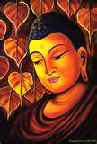
Siddharth Guatama
Indian Prince
Developed Buddhism

Slide 9
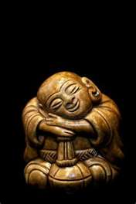
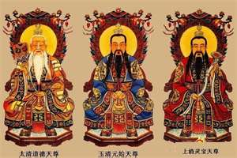

Slide 10
4 Holy Truths
Human existence involves much suffering
Human suffering occurs because human beings are self centered
Self centeredness can be overcome
The way to overcome self-centeredness is the 8 Fold Path

Slide 11
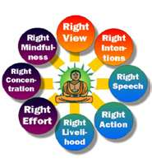

Slide 12
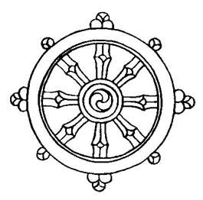
8 Fold Path
Right understanding; you must clearly see what is wrong with your life.
Right purpose; you must correct what is wrong

Slide 13
8 Fold Path
Right Conduct; you must act to correct the wrong.
Right Speech; you will speak in ways that help.

Slide 14
8 Fold Path
Right Vocation; your occupation must not conflict with your efforts to correct what is wrong.
Vanity/model
Alcoholic/ bar tender
Right Effort; you really must work at making a change.
Practice, Practice, Practice

Slide 15
8 Fold Path
Right Awareness; your effort must always be on your mind.
Right Meditation; you must meditate on correcting what is wrong: you must get your effort for change into your subconscious mind as well as the conscious mind.

Slide 16
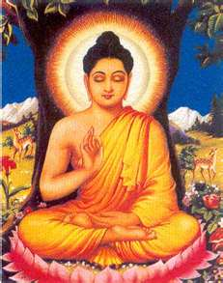
Buddha in Nepal

Slide 17
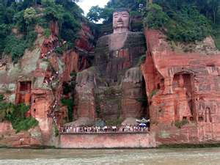
Leshan China Giant Buddha
World s Largest Buddha built in 713

Slide 18
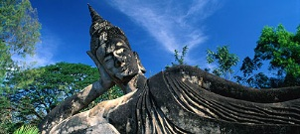
Buddha Vientiane Laos

Slide 19
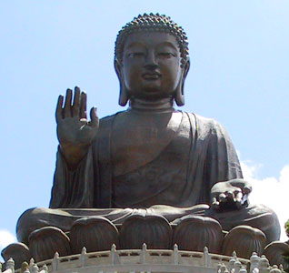
Buddha Hong Kong

