Slide 1
Unit 3 Cultural Patterns and Processes
13-17% of the AP Exam

Slide 2
Schools of Thought
Environmental Determinism
Possibilism
Environmental Perception
Cultural Determinism

Slide 3
Concepts of Culture
Non-material vs material
Acculturation
Assimiliation
Transculturation
Syncretism

Slide 4
Language
Chinese = most spoken (as a first language)
Indo-European languages = 50% of languages spoken in the world
Tree→ Branch→ group→ language

Slide 5
Lingua franca
Dialect
Pidgin

Slide 6
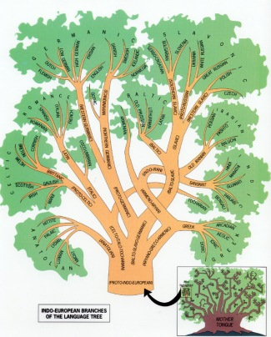

Slide 7
Religion
Universalizing
Ethnic
Christianity
Roman Catholicism
Eastern Orthodox
Protestant
Islam
Sunni
Shiite
Buddhism
Mahayana
Theravada
Jewish
Hinduism
Chinese Religions
Shintoism
Shamanism

Slide 8
Pop VS Folk

Slide 9
Unit 4 Political Organization of Space
13-17% of the AP Exam

Slide 10
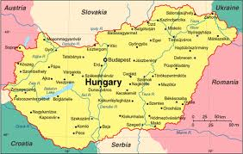
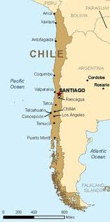
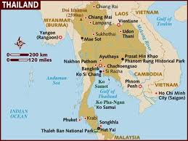
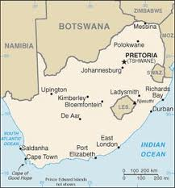
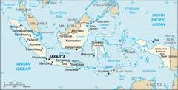
Territorial Morphology
Shapes of states
Compact
Prorupted
Elongated
Fragmented
Perforated

Slide 11
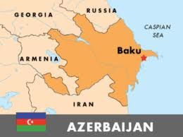
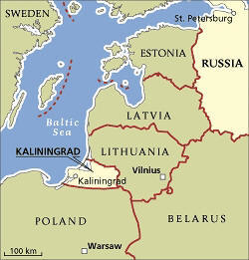
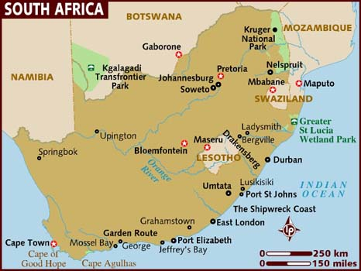
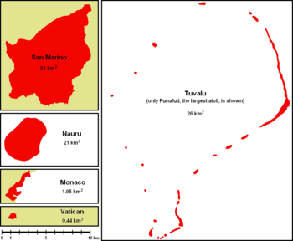
Exclaves
Enclaves
Microstates

Slide 12
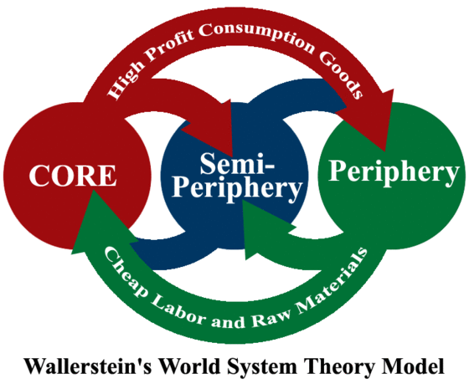
Worlds System Theory
Core
Semi Periphery
Periphery

Slide 13
Dependency Theory
Many countries are poor today because of their colonization by European powers

Slide 14
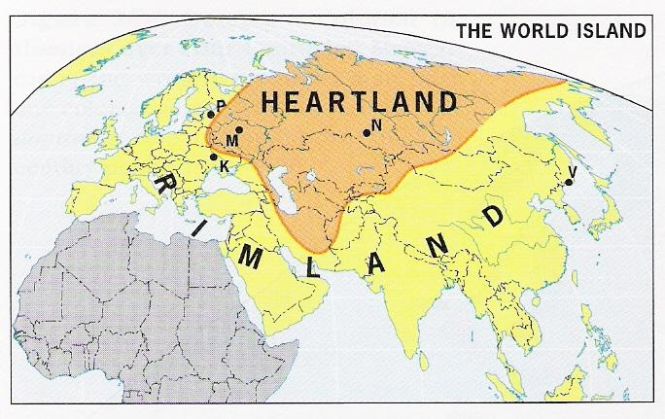
Geopolitics
Organic theory
Heartland theory
Rimland Theory

Slide 15
Capital Cities
Primate city
Biggest city in a country- more economically powerful than any other city in the state
Forward city
Built to achieve some national goal
Brasilia
Saint Petersburg

Slide 16
CentriFUgal vs CentriPETAL

Slide 17
Devolution
Balkanization
Centrifugal forces

Slide 18
Supranationalism
United Nations
NATO
NAFTA
European Union→ 27 countries
Only 17 use the Euro
Benelux
OPEC

Slide 19
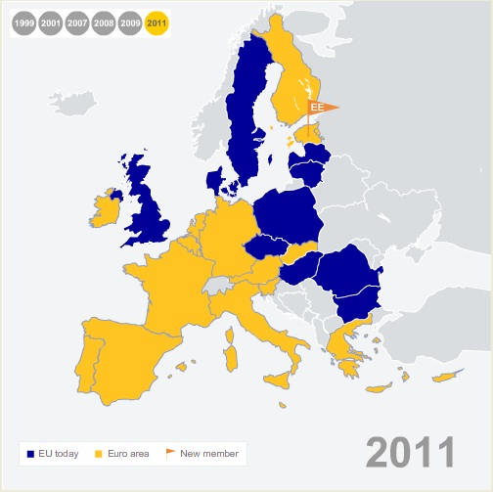

Slide 20
Unit 5 Agriculture and Rural Land Use
13-17% of the AP Exam

Slide 21
Agricultural Hearths
Root/Vegetative
Seed

Slide 22
Agricultural Revolutions
1st Agricultural Revolution
Domestication
2nd Agricultural Revolution
1600s- Western Europe
Enclosure movement
3rd Agricultural Revolution
Late 1800s
USA
Industrialization of Farming Process
Agribusiness

Slide 23
Types of Agriculture
Subsistence
Commercial

Slide 24
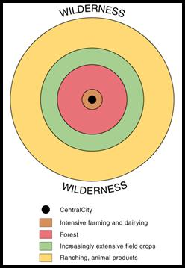
Von Thunen: Agricultural Location Theory
19th century- German economist

Slide 25
Von Thünen Model
Fig. 10-13: Von Thünen’s model shows how distance from a city or market affects the choice of agricultural activity in (a) a uniform landscape and (b) one with a river.

Slide 26
Example of Von Thünen’s Model
The example shows that a farmer would make a profit growing wheat on land located less than 4 kilometers from the market.
Beyond 4 kilometers, wheat is not profitable, because the cost of transporting it exceeds the gross profit.
More distant farms are more likely to select crops that can be transported less expensively.

Slide 27
Application of Von Thünen’s Model
Von Thünen based his general model of the spatial arrangement of different crops on his experiences as owner of a large estate in northern Germany during the early nineteenth century.
He found that specific crops were grown in different rings around the cities in the area.
Von Thünen did not consider site or human factors in his model, although he recognized that the model could vary according to topography and other distinctive physical conditions.
The model also failed to understand that social customs and government policies influence the attractiveness of plants and animals for a commercial farmer.
Although von Thünen developed the model for a small region with a single market center, it also applies to a national or global scale.

Slide 28
Green Revolution
Part of the 3rd Agricultural Revolution
Started in 1940s
Hybrid seeds and fertilizers
Higher-yielding varieties of wheat, rice, and maize crops
Successful in India
Many criticisms

Slide 29
Unit 6 Industrialization and Economic Development
13-17% of the AP Exam

Slide 30
Types of Economic Activities
Primary
Secondary
Tertiary
Quaternary
Quinary

Slide 31
Industrial Revolution
1750s-1850s
England
Coal and Steel
Industry = textile
Fueled by mercantilism and capitalism

Slide 32
Ford Production

Slide 33
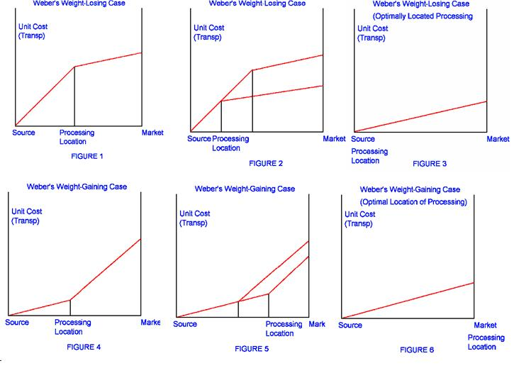
Weber’s Least Cost Theory

Slide 34
HDI- Human Development Index
Life expectancy
Average educational levels
Standard of living
GDP
Total value of outputs of foods and services produced in a country over one year

Slide 35
North-South Divide

Slide 37
Unit 7 Cities and Urban Land Use
13-17% of the AP Exam

Slide 38
Walter Christaller (1930s) Used to describe the pattern of urban places

Slide 39
Central Place Model: Variables
Hinterland = rural areas serviced by central places
Threshold = minimum number of people needed
Range= maximum travel distance
Spatial competition

Slide 40
Rank Size Rule
nth largest city’s population size = 1/n the size of the regions largest city popultion
4th largest city = ¼ the size of the regions largest city’s population size

Slide 41
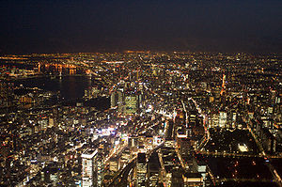
Megacities
Over 10 million inhabitants
NYC
Mexico City
Cairo
Jakarta

Slide 42
Borchert Model of Urban Evolution
Studied US cities:
Sail-Wagon Epoch (1790–1830),
Iron Horse Epoch (1830–1870), characterized by impact of steam engine technology, and development of steamboats and regional railroad networks.
Steel Rail Epoch (1870–1920), dominated by the development of long haul railroads and a national railroad network.
Auto-Air-Amenity Epoch (1920–1970), saw growth in the gasoline combustion engine
Satellite-Electronic-Jet Propulsion (1970-?), also called the High-Technology Epoch

Slide 43
Basic vs Non Basic
Basic = brings money into an urban place
Automobile manufacturing
Non-basic
- shifts money within the city, but doesn’t bring money in
-service jobs

Slide 44
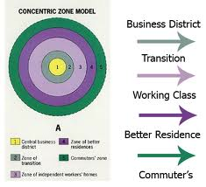
Concentric Zone Mode
1920s- 1st one- Chicago- Ernst Burgess

Slide 45
Sector Model 1930s- Hoyt

Slide 46
Multiple Nuclei Ullman and Harris-1945

Slide 47
Urban Realms-1970s help explain the growth and importance of suburban areas

Slide 49
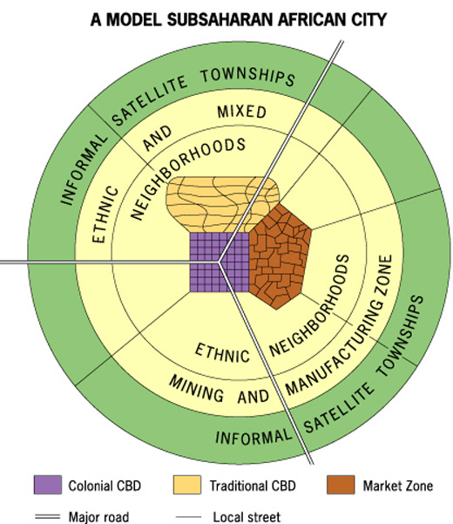

Slide 50
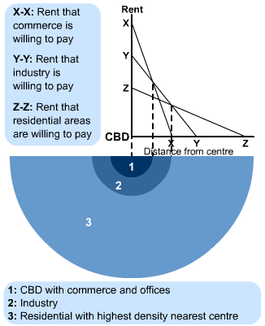
Notes:
http://www.s-cool.co.uk/a-level/geography/urban-profiles/revise-it/central-place-and-bid-rent-theories

